Slide 1




DYNAMIC TEMPORAL ANTIALIASING AND UPSAMPLING
in Call of Duty
Jorge Jimenez
Graphics R&D Technical Director - Activision Blizzard
SIGGRAPH Advances in Real-Time Rendering 2017 | Digital Dragons Programming and Technology Track 2018
Notes:
Note for the reader: this talk was first presented in Advances in Real-Time Rendering 2017. An slightly updated version was presented in Digital Dragons 2018. This slide deck corresponds to the updated 2018 presentation.
Hi,
My name is Jorge Jimenez,
I’m a Graphics R&D Technical Director at Activision Central Tech.
Over the past few years I worked on all current generation Call of Duty titles,
mostly focusing on characters and post effects.
In the last couple of years there has been a strong push towards 4k imaging,
with the recent introduction of the PS4 Pro and the Xbox One X.
As the resolution increased in the last two decades,
it became more and more important
to leverage spatial and temporal information to reduce the shading costs.
In this presentation I’ll be talking about
the dynamic antialiasing solution that we shipped in Infinite Warfare and World War 2,
and the experimental technology created towards the end of the projects
that we hope to ship in future games.

Slide 2
Notice for Offline Reading
Hidden slides in this presentation with extra information
Slide show mode won’t show them
Don’t miss the speaker notes, visible slides have them

Slide 3
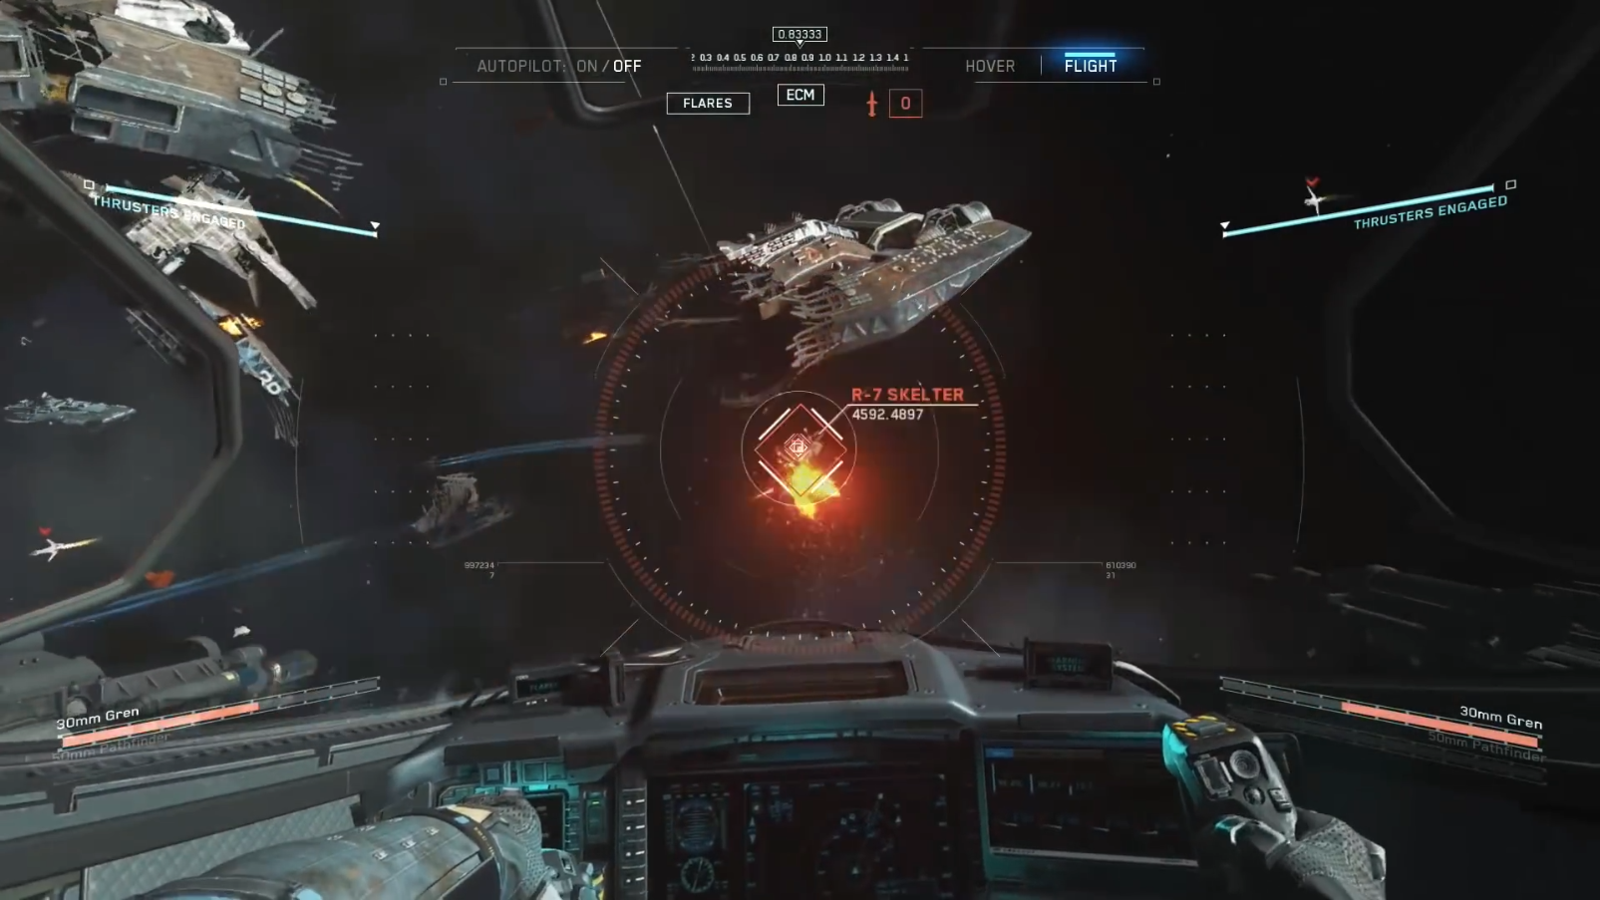
© 2017 Activision Publishing, Inc.
Notes:
So lets start by motivating what is this
all about.
And for that, let me use this scene.
Here we have the first frame of the sequence…

Slide 4
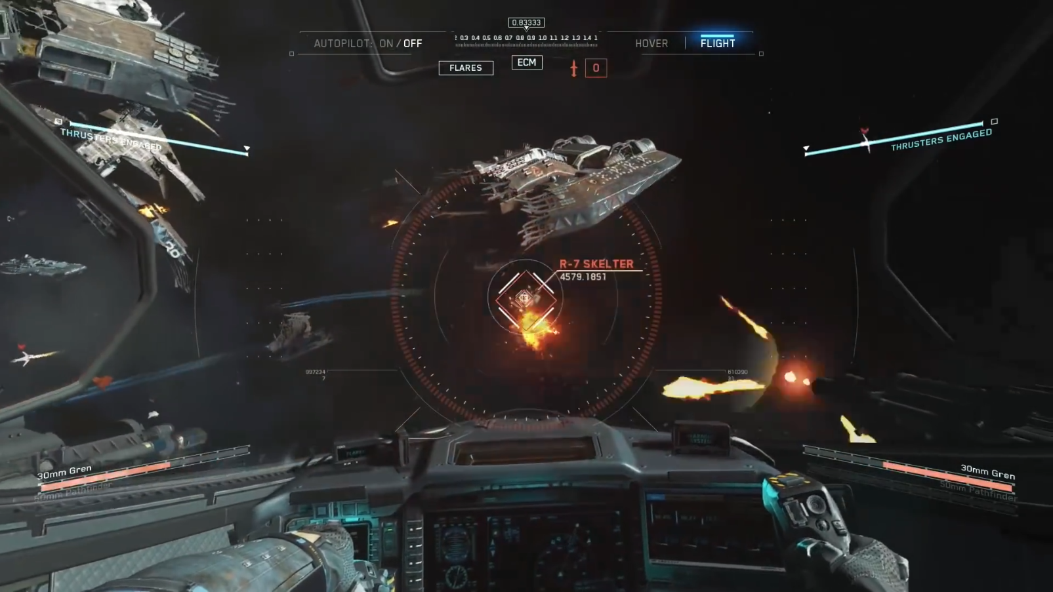
© 2017 Activision Publishing, Inc.
Notes:
…and here the second.
[back and forth]
Most of the screen remained the same, even if it slightly moved.
In the past, we thrown all the pixels that we shaded in the previous frames, and started from scratch.
But that doesn’t seem to be a very good idea.
Temporal supersampling essentially allow to reuse this information from frame to frame,
rather than doing everything from scratch.

Slide 5
© 2017 Activision Publishing, Inc.
Notes:
Of course this not easy, because as mentioned before,
things move.
So we need to know where a pixel was in the previous frame.
And for that, velocities, or also called motion vectors, are used.
For example, here we have the velocity for a pixel,
which is illustrated in green here.

Slide 6

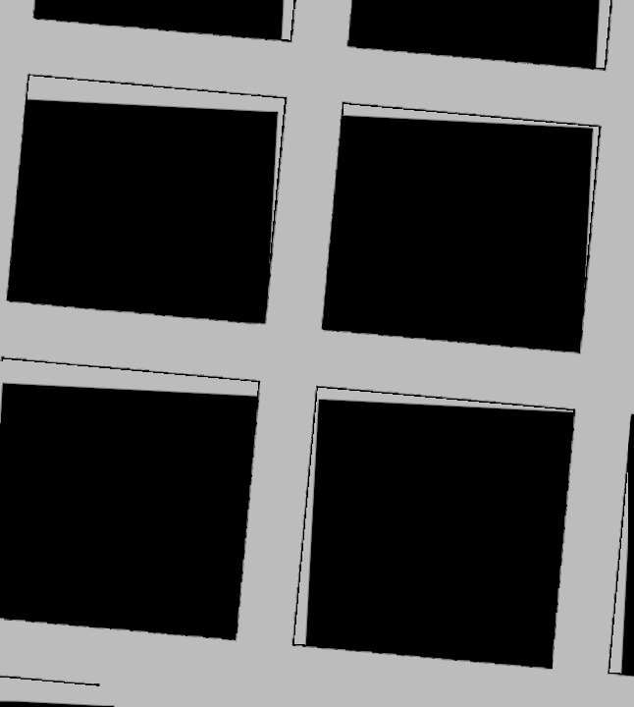
Reprojection Ghosting
Without
Temporal Supersampling
With
Temporal Supersampling
Notes:
Then again, this is not going to be so easy.
If we reproject to a place where the object
was not visible in the previous frame,
we get ghosting.
There are one million ways to deal with this.
And one million issues that raise from trying to fix the issue.
But the most typical solution is to use the neighborhood clamp…

Slide 7
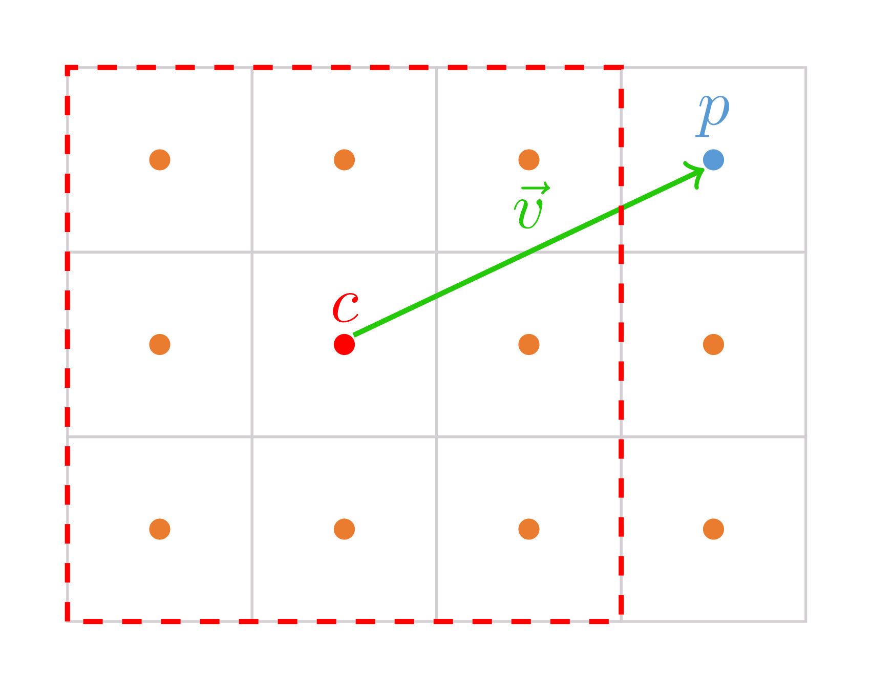
Neighborhood Clamp [Lottes2011]
Notes:
…which consists in restricting the reprojected pixel p, in blue here,
to the color range in the neighborhood around the current frame pixel c, in red here.

Slide 8
Filmic SMAA
Morphological Component
Temporal Supersampling Component
Temporal Filtering Component
[Jimenez2016] Filmic SMAA: Sharp Morphological and Temporal Antialiasing
Notes:
So, that was a quick recap of what is temporal AA,
and for more details, I’ll refer you to the presentation on screen.
Here, we are using Filmic SMAA as basis,
but the upsampler we are about to present is an orthogonal extension to it,
with most of the ideas being applicable to any temporal AA technique.

Slide 9
Overview
Dynamic AA 2x – Filmic SMAA TU2x
Dynamic AA 4x – Filmic SMAA TU4x
New Temporal Toolset:
1-Sample Spatio-Temporal Bicubic Resampling
Fast Temporal Wide Resolves
Dynamic Subpixel Jittering
Halfres Velocity Packing
Bit Depth Aware Exponential Accumulation Blending

Slide 10
Dynamic Resolution and Infrastructure
Adam Micciulla
Akimitsu Hogge
Angelo Pesce
Michael Vance
Michal Drobot
Wade Brainerd
Notes:
Before I continue,
I’d like to mention that this was a collaborative effort,
with many pieces working together in a single system.
Everybody on this slide was key to make this happen.

Slide 11
Intro
Dynamic resolution widely used for 60fps games
Change output resolution according to load
Light workload
Heavy workload
Notes:
Dynamic resolution is nowadays, a commonly used tool in 60 fps games,
where fluid frame rate has absolute priority.
The idea is simple, under light workload,
we render 1080p images.
Then, under high workload,
the resolution is reduced to guarantee a smooth frame rate.

Slide 12
Intro
Temporal upsampling deployed on many PS4 Pro titles
Combine previous and current frame for a higher resolution image
Current Frame
Previous Frame
Output Frame
Notes:
On the other hand, we have temporal upsampling,
where two different frames are assembled together for a higher resolution image.

Slide 13
Intro
Dynamic Resolution + Temporal upsampling Problem
Light workload
Heavy workload
Notes:
But, what happens if we want to use both?

Slide 14
Intro
Dynamic Resolution + Temporal upsampling Problem
Output Size
Output Size
Light workload
Heavy workload
Notes:
If we combine both techniques, the upsampled image,
which is marked with green and blue here,
will always be bigger than the output size,
which is marked on orange,
meaning that we guarantee a 1080p image.
But note that in the light workload case
we are creating a bigger image than the output size.
So, what we can do with all that extra information?
We are going to use it to increase the antialiasing quality.

Slide 15
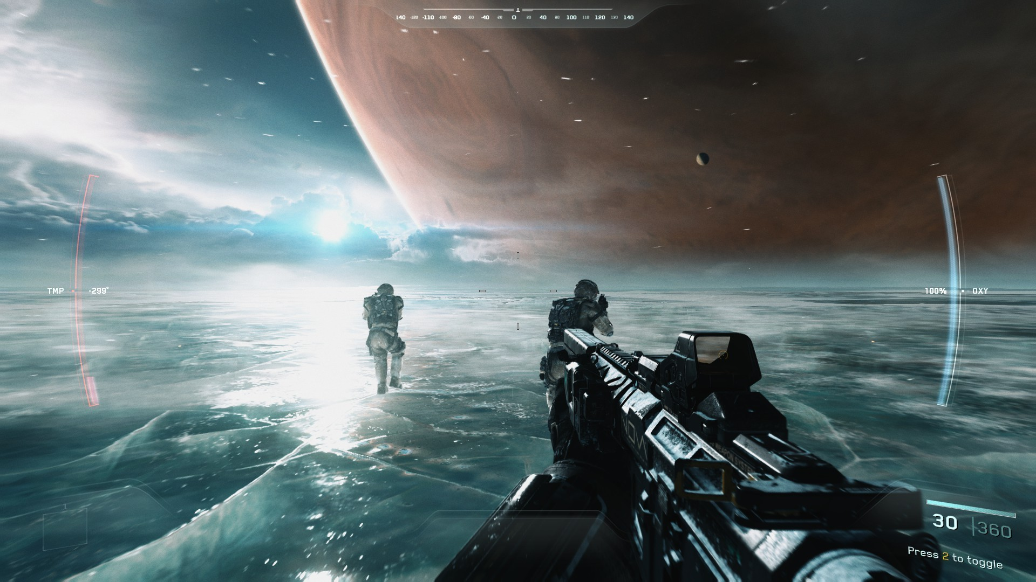
Filmic SMAA TU2X Dynamic AA 2X
© 2017 Activision Publishing, Inc.
Notes:
So, let’s dive into the first part, Filmic SMAA TU2x.

Slide 16
Filmic SMAA TU2x Highlights
Dynamic resolution + temporal upsample combo
Rather than virtually vary the resolution, vary the antialiasing quality
Always outputs 1080p
On the upper end: 2x supersampling
On the lower end: 1x supersampling
In between: 1x to 2x supersampling
Can directly upsample from any resolution to 1080p
From [960x1080, 1920x1080]
Rather than just from 960x1080
Notes:
This technique allows to combine dynamic resolution and temporal upsampling
in such a way that rather than varying the resolution,
we vary the antialiasing quality.
We always output 1080p.
On the upper end of the dynamic resolution, we output 2x supersampling.
On the lower end, we output 1x.
And then, in between, we have a variable antialiasing quality from 1 to 2x.
So, that means that we can directly upsample
from any resolution higher than 960 by 1080 to full hd.

Slide 17
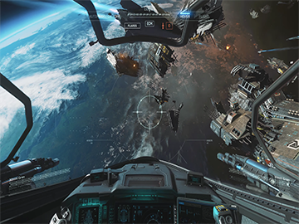


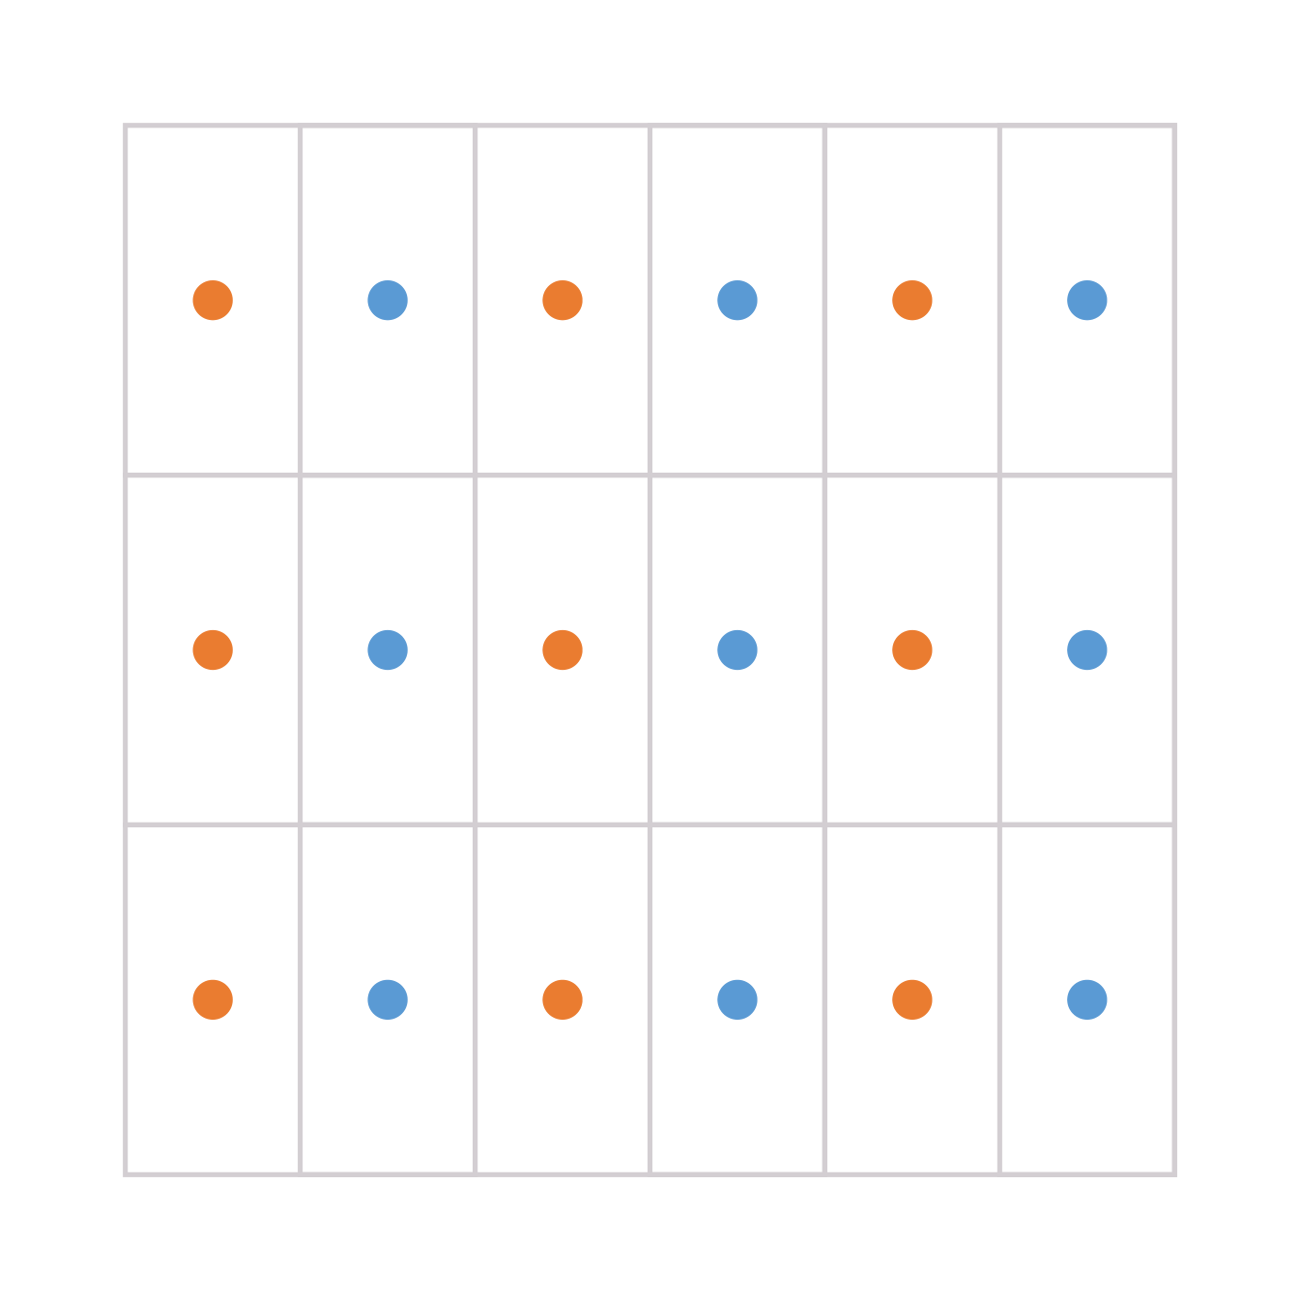
Big Picture
Current Frame 1440x1080
Odd Columns
Virtual 2880x1080
Final 1920x1080
With horizontal supersampling
Previous Frame 1440x1080
Even Columns
Notes:
So, here we have the big picture.
We can see how the previous and current frames
are used to assemble a virtual image of twenty eight eighty by ten eighty,
which is then bilinearly downsampled to target output resolution.

Slide 18
Big Picture
Dynamic resolution: (our previous setup)
Dynamic AA:
Scene Buffer
SMAA
AAed Scene Buffer
Bilinear
Upsample
Framebuffer
1200x1080 (for example)
Antialiasing
1200x1080
1920x1080
Scene Buffer
SMAA
Framebuffer
1200x1080 (for example)
Antialiasing
1920x1080
Notes:
Notice that for the case of using dynamic resolution,
antialiasing runs before a bilinear upsample.
In the dynamic AA approach,
antialiasing directly resamples to 1080p.

Slide 19
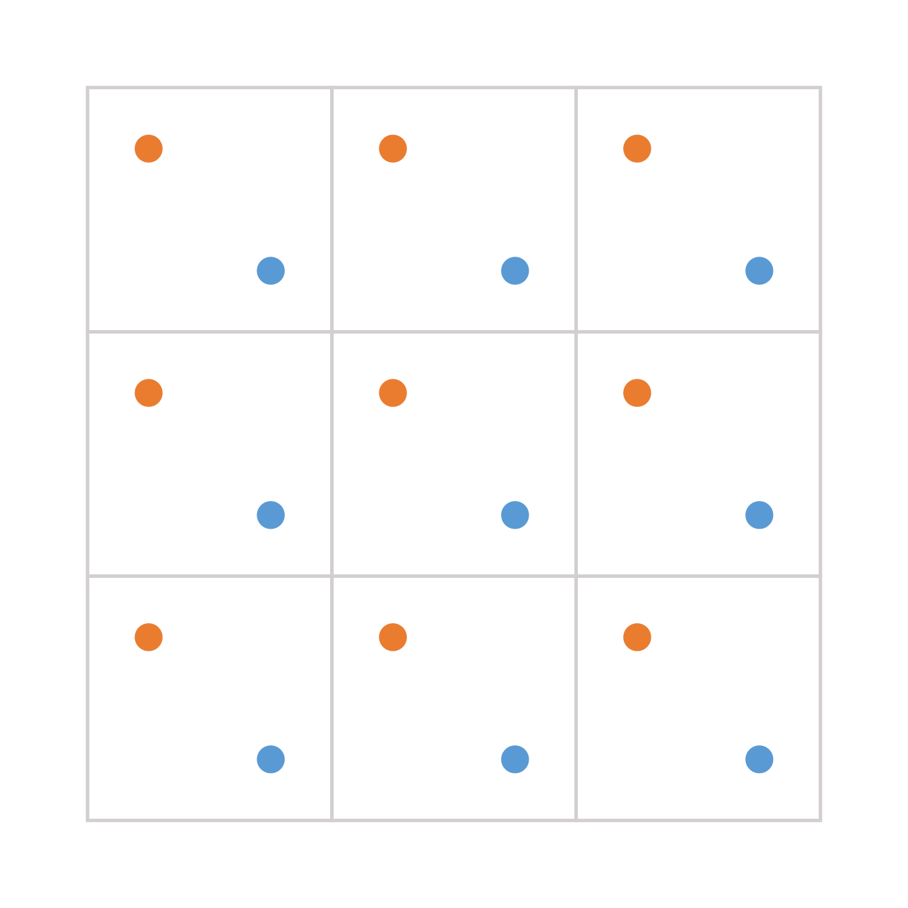
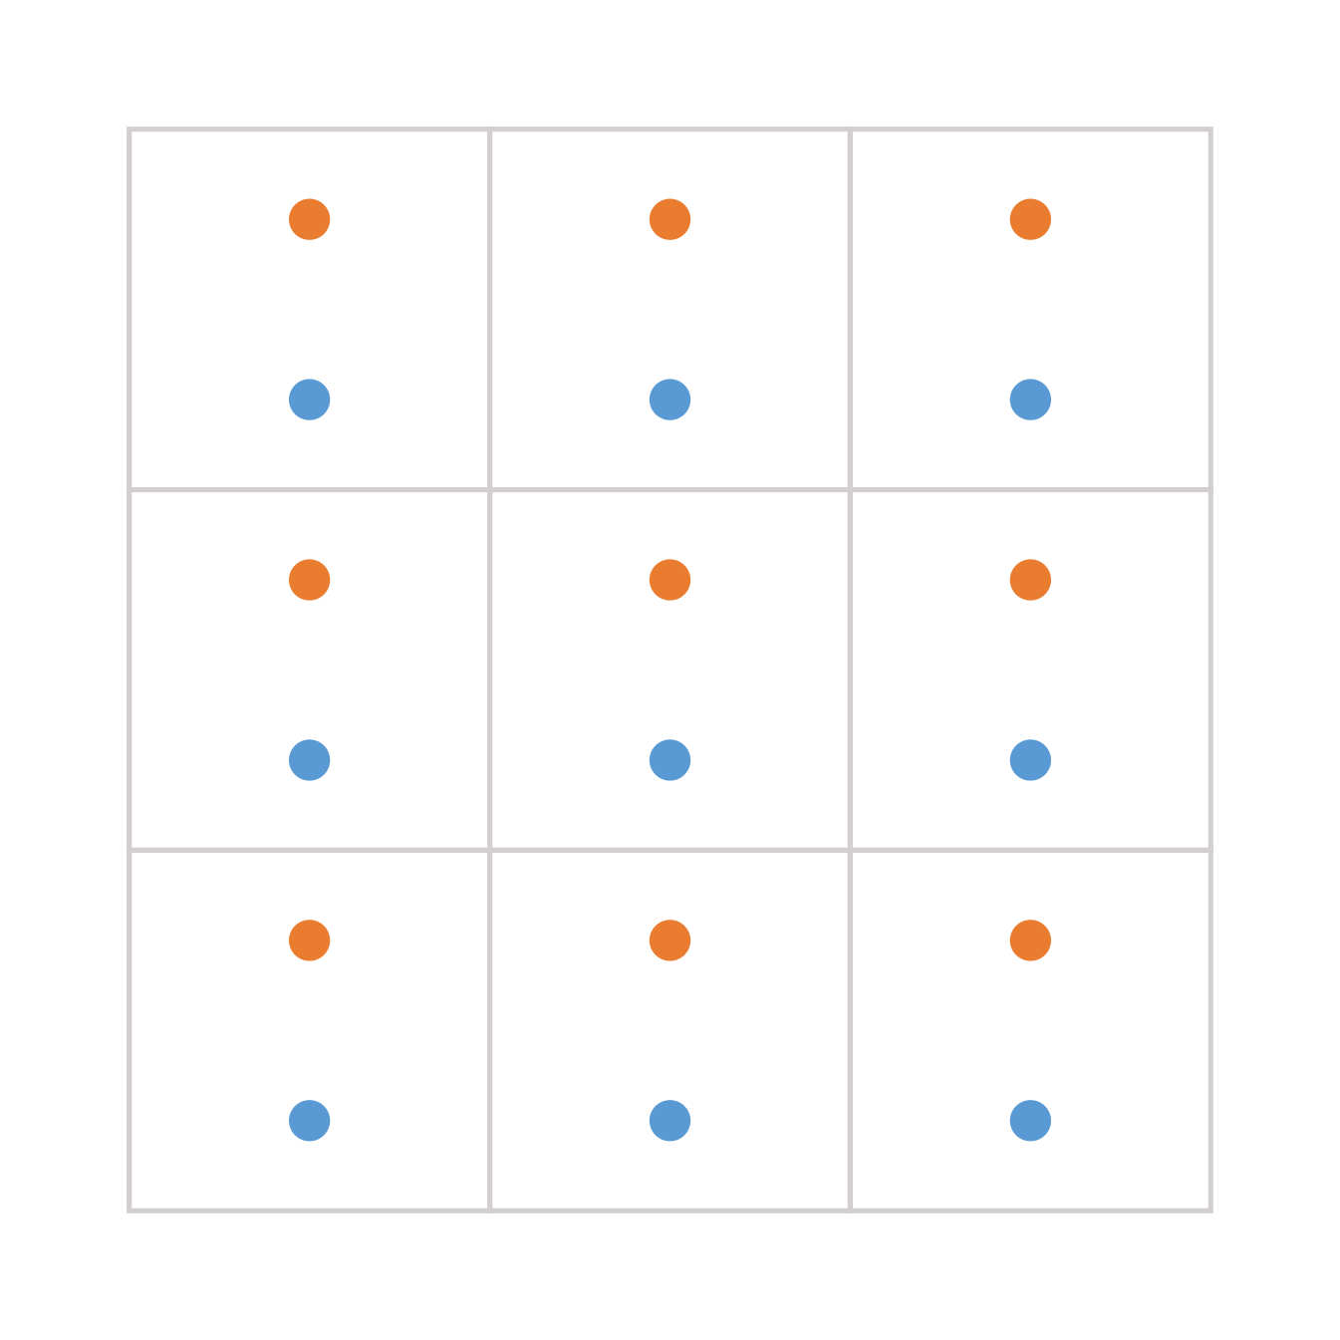
Subpixel Jittering
SMAA T2x
(Default Diagonal Jitter)
SMAA T2x
(Horizontal Jitter)
New SMAA TU2x Upsampler
Based on [Valient2014]
Notes:
Here on the left we have typical 2x diagonal supersampling.
For upsampling, the first step is to switch to an horizontal jitter.
Then, rather than blending the subsamples as we see on the middle,
we output them as individual pixels.
For those not familiar with supersampling, you can think of this as generating two different images,
moving the camera a little bit horizontally,
and then interleaving these two images together,
which doubles the image resolution.

Slide 20
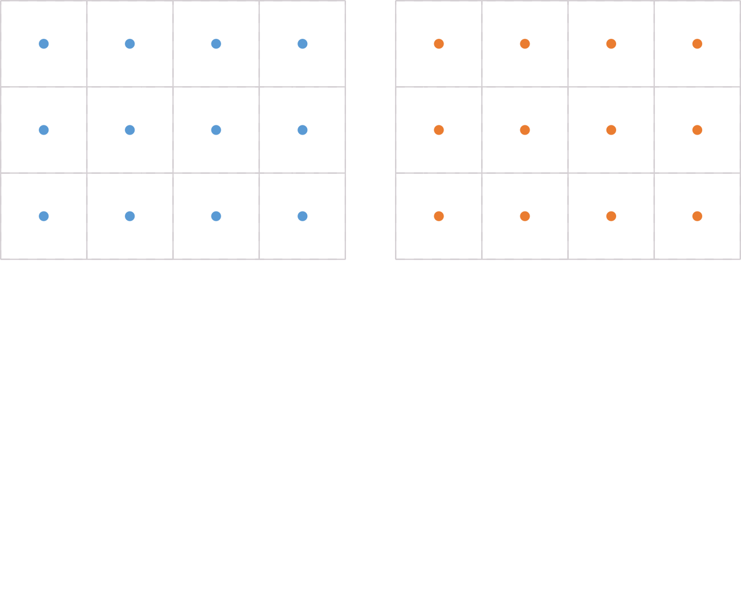
Virtual Bilinear Downsample
We start from current and previous frames
Rendered with different horizontal subpixel offsets
Previous Frame
Current Frame
Notes:
So, we have correctly placed previous and current frame pixels.

Slide 21
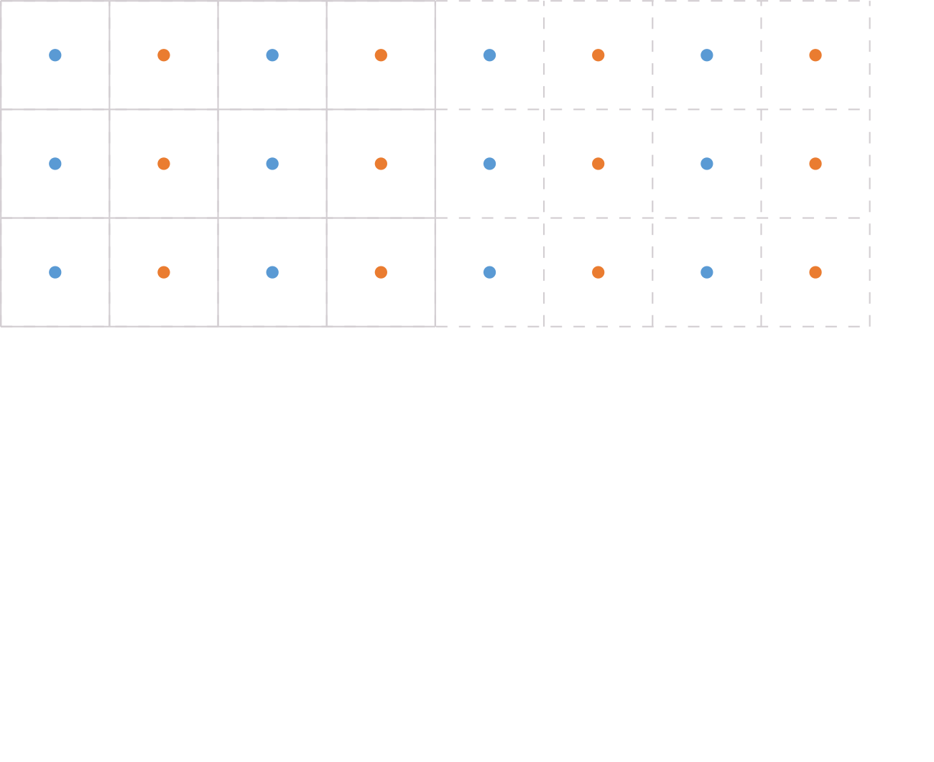
Virtual Bilinear Downsample
We build a 2x virtual image by interlacing the previous and current frames
Virtual 2x Image
Notes:
From there we build a 2x virtual image by interlacing these pixels.

Slide 22
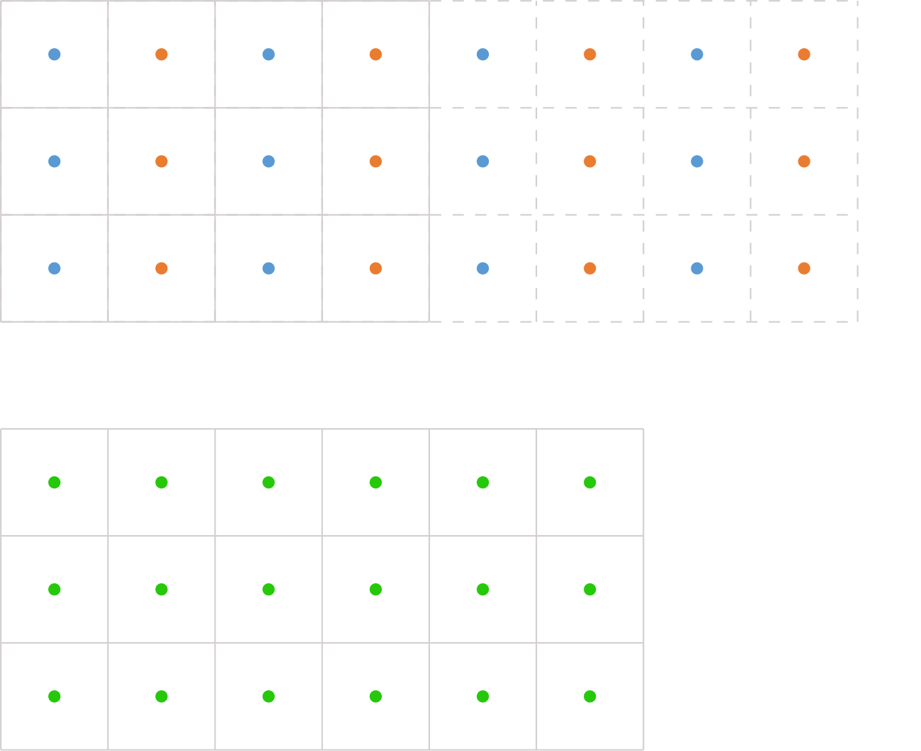
Virtual Bilinear Downsample
However our output image is smaller
Virtual 2x Image
Output Image
Notes:
But, as mentioned before,
now our output image is smaller than the virtually upsampled one.

Slide 23
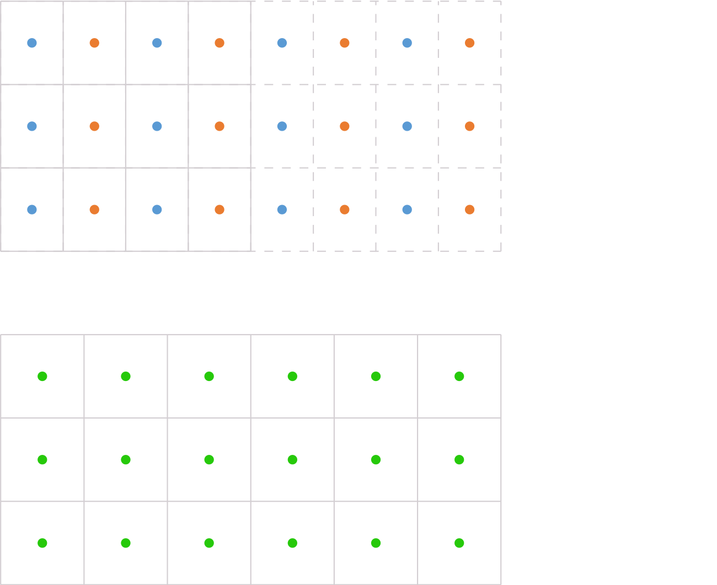
Virtual Bilinear Downsample
We downsample the virtual 2x image to output resolution
Virtual 2x Image
Output Image
Notes:
So, what we want to do
is to bilinear downsample this virtual image.

Slide 24
Dynamic AA Algorithm
Virtual 2x Image
First step:
Calculate position of output image pixel in the virtual 2x image
Bilinear weight will be the fractional of this position
weight
Output Image
float upsampledPosition = 2.0 * inputDimensions.x * texcoord.x - 0.5;
float weight = frac(upsampledPosition);
Notes:
For that, the first step is to calculate the position of the output pixel,
marked with a red circle,
on the virtual image, marked with a red square.
The bilinear weight will be the fractional of this position,
as shown in the figure.

Slide 25


Dynamic AA Algorithm
Second step:
Odd positions need to lerp across 2-pixel block boundaries
mod2
odd position
mod2
0
1
0
1
subsampleIndex = 0
subsampleIndex = 1
previous
current
current
previous
int mod2 = SMAAMod2(upsampledPosition);
float currentOffset = mod2 && subsampleIndex? 1.0 : 0.0; // | c | p | -> | . | p | c |
float previousOffset = mod2 && !subsampleIndex? 1.0 : 0.0; // | p | c | -> | . | c | p |
Notes:
Odd positions need to lerp across 2-pixel block boundaries,
which means that for example,
for the position marked in red…

Slide 26
Dynamic AA Algorithm
Second step:
Odd positions need to lerp across 2-pixel block boundaries
For them, offset current or previous frame colors
mod2
mod2
0
1
0
1
subsampleIndex = 0
subsampleIndex = 1
previous
current
current
previous
int mod2 = SMAAMod2(upsampledPosition);
float currentOffset = mod2 && subsampleIndex? 1.0 : 0.0; // | c | p | -> | . | p | c |
float previousOffset = mod2 && !subsampleIndex? 1.0 : 0.0; // | p | c | -> | . | c | p |
Notes:
…we would need to move the previous pixel to its right.

Slide 27
Dynamic AA Algorithm
Third step:
Apply previously calculated offsets
Snap to input texel centers
Convert to texture coordinates
Beware slightly optimized code below
texcoord.x = (1.0 / inputDimensions.x) * (floor(0.5 * (floor(upsampledPosition) + currentOffset ) + 0.25) + 0.5);
previousTexcoord.x = (1.0 / inputDimensions.x) * (floor(0.5 * (floor(upsampledPosition) + previousOffset) + 0.25) + 0.5);
Notes:
The next step is to apply those offsets,
to snap to input texel centers,
and to convert to texture coordinates.

Slide 28
Dynamic AA Algorithm
Fourth step:
Blend of current and previous has current on the left
If previous frame color is on the left, reverse the weight
weight
1 - weight
current
previous
previous
current
bool subsampleSwap = SMAAXor(subsampleIndex, mod2);
weight = subsampleSwap? weight : 1.0 – weight;
outputColor = lerp(currentColor, previousColor, weight);
Notes:
Then, the final step needs to account for the fact
that we always blend current and previous colors assuming that the current one is on the left.
If that assumption doesn’t hold, we need to reverse the weight.

Slide 29
float SMAATemporalUpsample2x(int subsampleIndex, in out float2 texcoord, in out float2 previousTexcoord, out bool subsampleSwap)
{
// Calculate position on a virtual 2x sized render target:
float upsampledPosition = 2.0 * SMAA_TEMPORAL_INPUT_RT_METRICS.z * texcoord.x - 0.5;
// If debug is enabled, output the virtual 2x sized render target:
#if SMAA_TEMPORAL_DEBUG == SMAA_TEMPORAL_DEBUG_UPSAMPLE
return SMAATemporalUpsample2xDebug(upsampledPosition, subsampleIndex, texcoord, previousTexcoord);
#endif
// Odd and even columns need to be processed differently:
int mod2 = SMAAMod2(upsampledPosition);
// Reference for current and previous frame pixel locations:
// mod2
// 0 1
// subsampleIndex 0: | p | c |
// 1: | c | p |
// If we are in odd pixels, we need to lerp across 2-pixel block boundaries:
float currentOffset = mod2 && subsampleIndex? 1.0 : 0.0; // | c | p | -> | . | p | c |
float previousOffset = mod2 && !subsampleIndex? 1.0 : 0.0; // | p | c | -> | . | c | p |
// Snap to input resolution pixel centers:
texcoord.x = SMAA_TEMPORAL_INPUT_RT_METRICS.x * (floor(0.5 * (floor(upsampledPosition) + currentOffset ) + 0.25) + 0.5);
previousTexcoord.x = SMAA_TEMPORAL_INPUT_RT_METRICS.x * (floor(0.5 * (floor(upsampledPosition) + previousOffset) + 0.25) + 0.5);
// This weight will lerp between previous and current frame colors as if we were bilinearly downsampling this
// virtual 2x render target to the output resolution:
float weight = frac(upsampledPosition);
// If previous is to the left of current pixel, we need to reverse the lerp:
subsampleSwap = SMAAXor(subsampleIndex, mod2);
weight = subsampleSwap? weight : 1.0 - weight;
return weight;
}

Slide 30
Filmic SMAA TU2x Highlights
Dynamic resolution + temporal upsample combo
Rather than virtually vary the resolution, vary the antialiasing quality
Always outputs 1080p:
On the upper end: 2x supersampling
On the lower end: 1x supersampling
In between: 1x to 2x supersampling
Can directly upsample from any resolution to 1080p
From [960x1080, 1920x1080]
Rather than just from 960x1080
Notes:
Coming back to the technique highlights,
notice that we only do 1x supersampling on the lower end.
We have morphological antialiasing and temporal filtering for stability,
but we are still missing subpixel rendering for the lower dynamic resolutions.

Slide 31
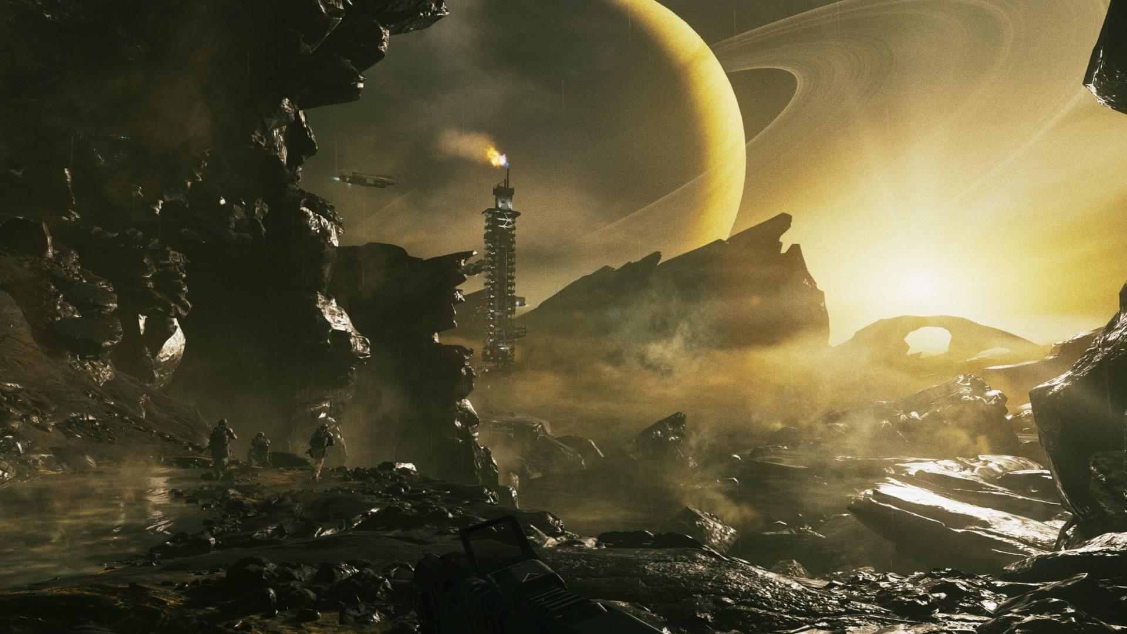
Filmic SMAA TU4X Dynamic AA 4X
© 2017 Activision Publishing, Inc.
Notes:
So, this is where the TU4x mode comes into play.

Slide 32
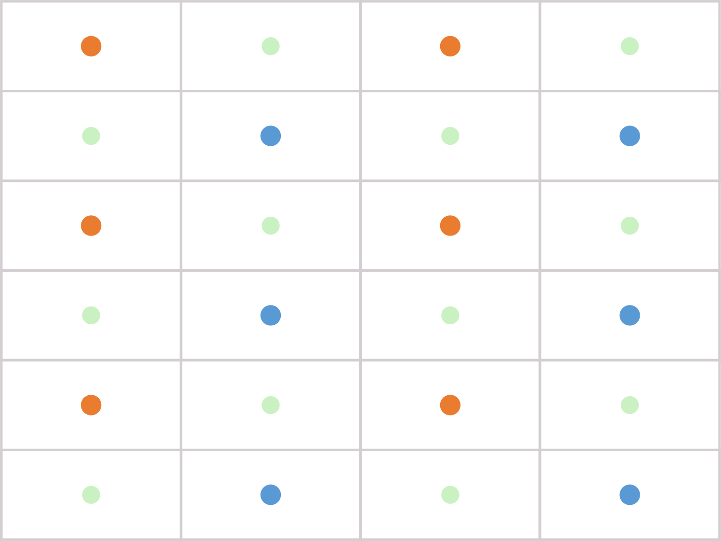
Filmic SMAA TU4x
Presented method so far can do up to 2x upsampling
We have an experimental method that can do up to 4x upsampling
Uses diagonal jitter rather than horizontal:
Current frame
Previous frame
Reconstructs:
Missing samples from orange and blue samples
Notes:
To increase the subpixel rendering quality
we will upsample to a virtual 4x bigger image.
To accomplish that, we will use a diagonal jitter rather than an horizontal one.
In the following slides I’ll show how we reconstruct the green samples
from the orange and blue ones,
which correspond to the current and previous frames respectively.

Slide 33


Filmic SMAA TU4x
Pixel art upsampling algorithms have been doing similar reconstructions (hqx)
Core difference is that the input here is checkerboarded => Easier reconstruction
Similar problem to demosaicing [Phelippeau2009]
We extended the highly efficient [Berghoff2016] differential blend to a temporal checkerboard
HQX Input
HQX Output
Notes:
There exists an extensive collection of pixel art techniques that do this for orthogonal grids.
But fortunately, diagonal ones are much easier to handle.
Berghoff recently introduced the differential blend method,
which allows to very efficiently reconstruct missing information on checkerboard inputs.
We will extend this method to handle a temporal checkboard rather than a spatial one.

Slide 34
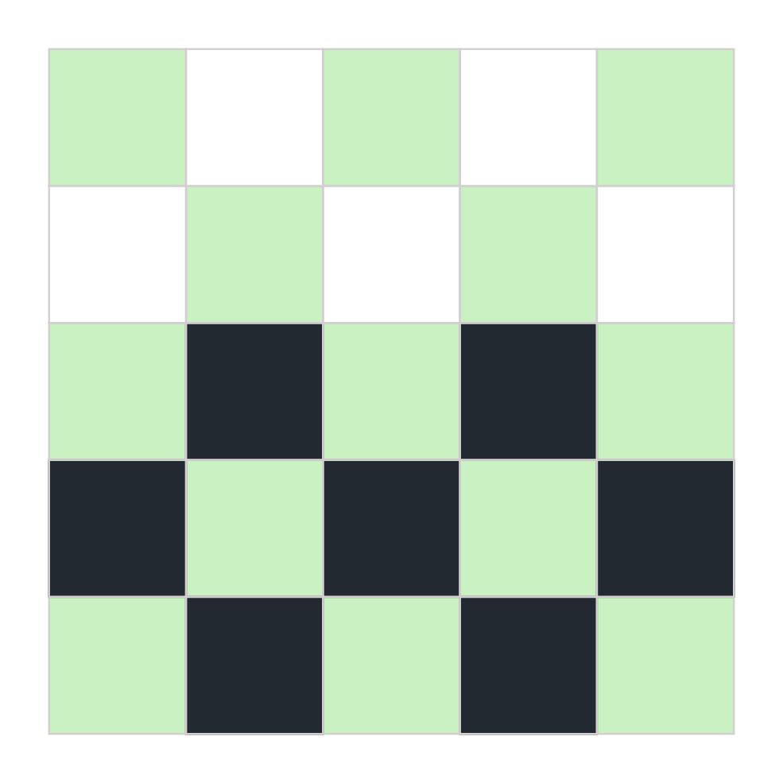
[Berghoff2016] Differential Blend Recap
This is the checkerboarded input
Green pixels are missing
Notes:
Before continuing, let me recap the original technique.
This is the checkboarded input,
where the green pixels are missing.

Slide 35
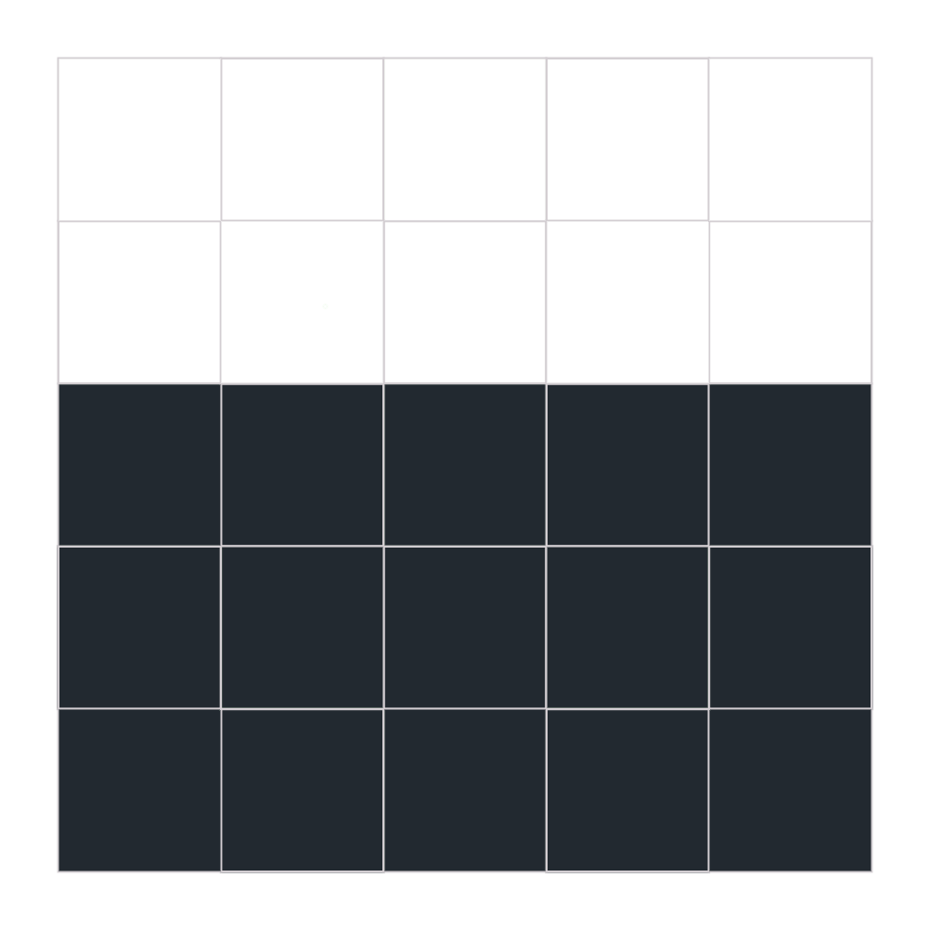
[Berghoff2016] Differential Blend Recap
This is the target ideal reconstruction
Notes:
And this is the ideal reconstruction using that information.

Slide 36

[Berghoff2016] Differential Blend Recap
Determine color of current pixel by checking horizontal and vertical neighbor blends
Keep the neighbor blend with the lowest color difference
Notes:
The color of the pixel marked in red is determined
by checking the horizontal and vertical neighbors.
We will blend either vertically or horizontally
depending on which direction has the lowest color difference.

Slide 37
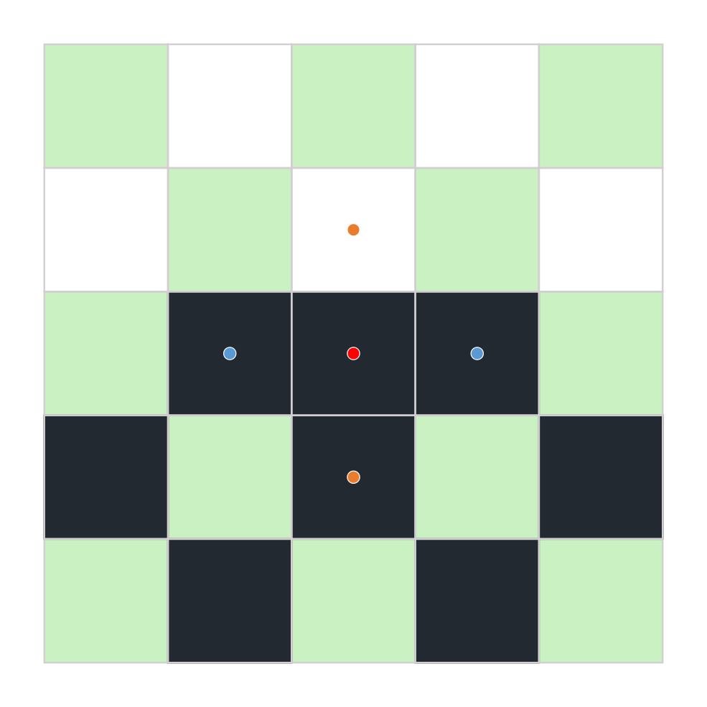
[Berghoff2016] Differential Blend Recap
Determine color of current pixel by checking horizontal and vertical neighbor blends
Keep the neighbor blend with the lowest color difference
For the current pixel, that would be the horizontal blend
Notes:
So, for the this case we would blend horizontally.

Slide 38
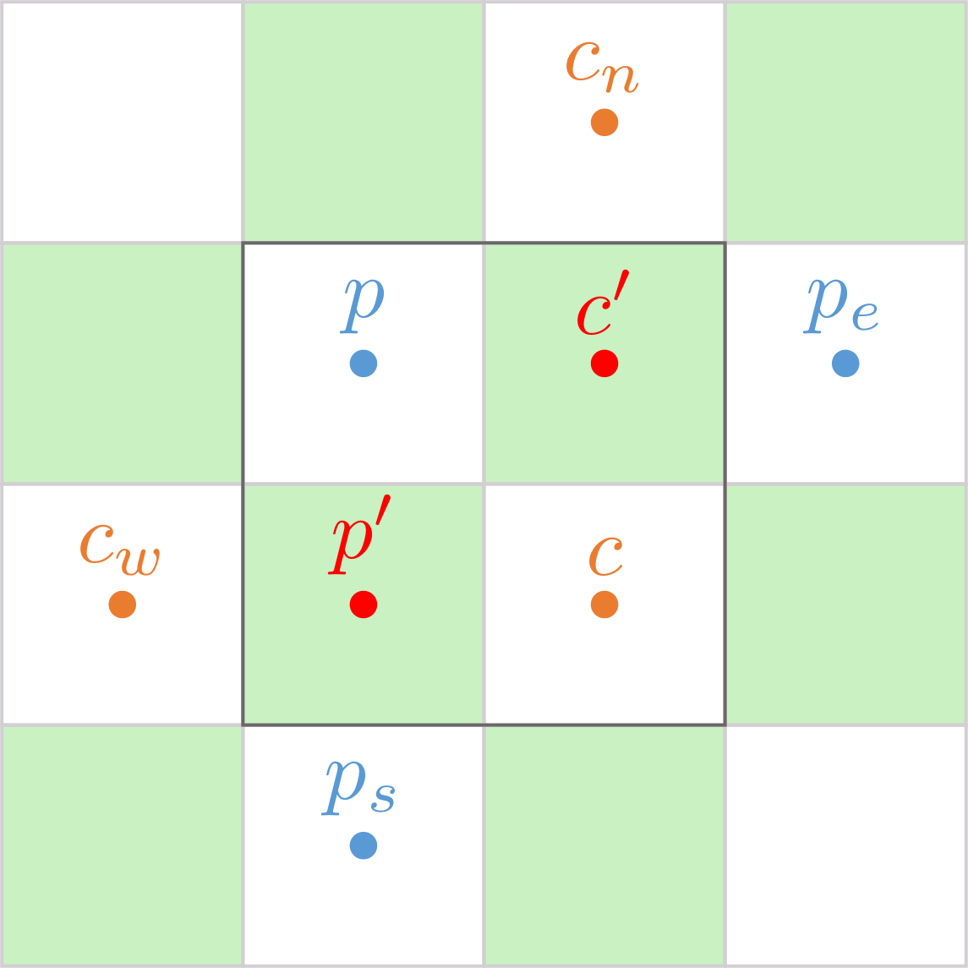
Temporal Checkerboard
float3 neighborhood1[4] = {
currentNeighborhood[SMAA_NEIGHBORHOOD_WEST], // SMAA_NEIGHBORHOOD_WEST
currentColor, // SMAA_NEIGHBORHOOD_EAST
previousColor, // SMAA_NEIGHBORHOOD_NORTH
previousNeighborhood[SMAA_NEIGHBORHOOD_SOUTH] // SMAA_NEIGHBORHOOD_SOUTH
};
float3 neighborhood2[4] = {
previousColor, // SMAA_NEIGHBORHOOD_WEST
previousNeighborhood[SMAA_NEIGHBORHOOD_EAST], // SMAA_NEIGHBORHOOD_EAST
currentNeighborhood[SMAA_NEIGHBORHOOD_NORTH], // SMAA_NEIGHBORHOOD_NORTH
currentColor // SMAA_NEIGHBORHOOD_SOUTH
};
float3 weights = SMAADifferentialBlendCalculateWeight(neighborhood1, neighborhood2);
float3 previousReconstructedColor = SMAADifferentialBlend(neighborhood1, weights); // p'
float3 currentReconstructedColor = SMAADifferentialBlend(neighborhood2, weights); // c‘
previousColor = lerp(previousColor, previousReconstructedColor, 0.5);
currentColor = lerp(currentColor, currentReconstructedColor, 0.5);
float3 SMAADifferentialBlend(float3 neighborhood[4], float3 weights)
{
float4 color = 0.0;
color += float4(neighborhood[SMAA_NEIGHBORHOOD_WEST] + neighborhood[SMAA_NEIGHBORHOOD_EAST], 1.0) * weights.x;
color += float4(neighborhood[SMAA_NEIGHBORHOOD_NORTH] + neighborhood[SMAA_NEIGHBORHOOD_SOUTH], 1.0) * weights.y;
return (0.5 * weights.z) * color.rgb;
}
Notes:
Here we have the temporal checkerboard.
For a given pixel, we need to determine the pixels p and c,
using the algorithm presented in the TU2x method.
From there we will reconstruct the pixel c prime and p prime using differential blends.

Slide 39


Temporal Checkerboard
Downsample (Average)
Filmic SMAA TU2x
960x1080 to 1920x1080
Filmic SMAA TU4x
960x1080 to 1920x1080 + 2xAA
Notes:
Once we have reconstructed those pixels,
we simply perform a 2x vertical downsample.
On one hand, p and p prime…

Slide 40
Temporal Checkerboard
Downsample (Average)
Filmic SMAA TU2x
960x1080 to 1920x1080
Filmic SMAA TU4x
960x1080 to 1920x1080 + 2xAA
Notes:
…and c prime and c on the other.
This yields 2x vertical antialiasing as can be seen in the comparison on the right.

Slide 41
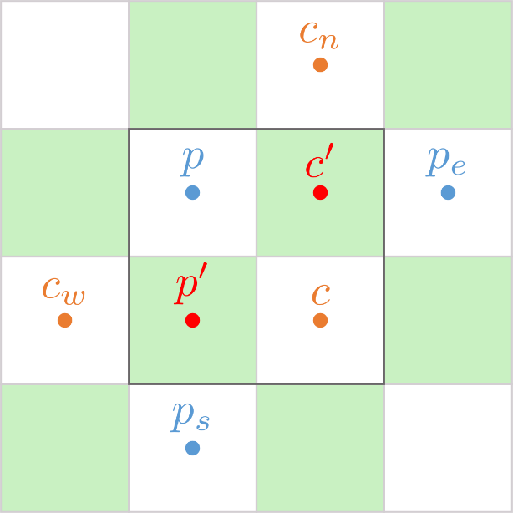
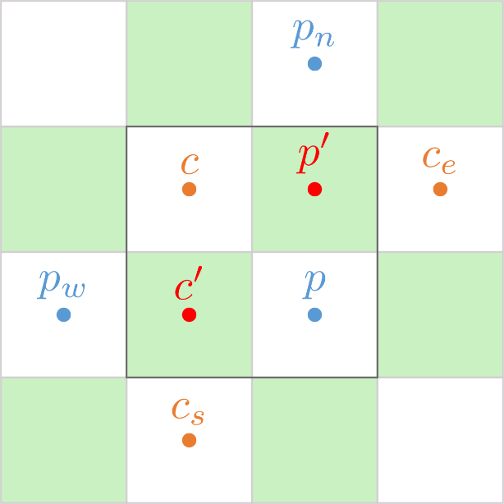
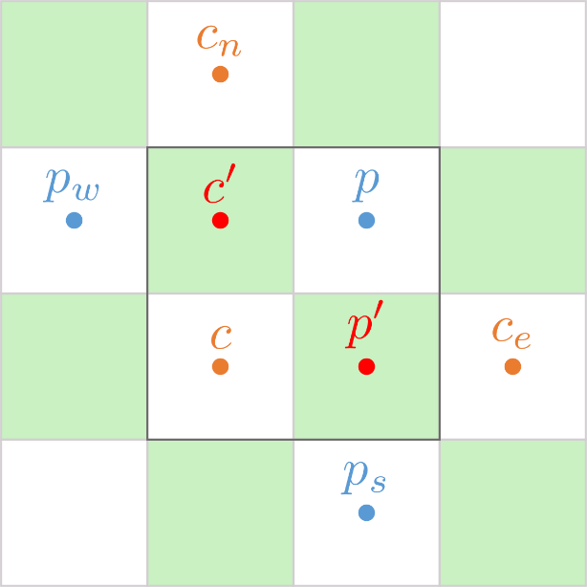
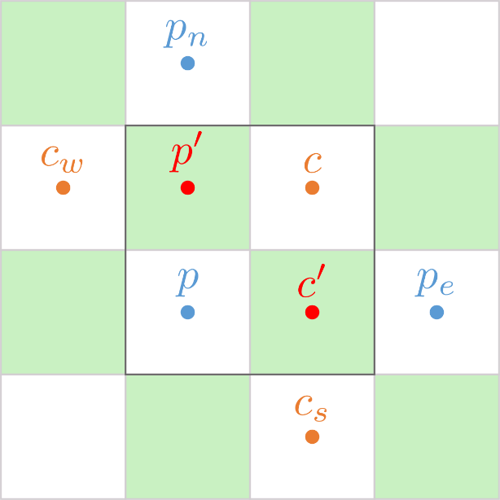
Temporal Checkerboard Permutations
Permutations are mirrors along x and y axes
Handle permutations by mirroring offsets of texture coordinates before fetching neighborhoods
subsampleIndex = 0
subsampleSwap = 0
subsampleIndex = 1
subsampleSwap = 0
subsampleIndex = 0
subsampleSwap = 1
subsampleIndex = 1
subsampleSwap = 1

Slide 42
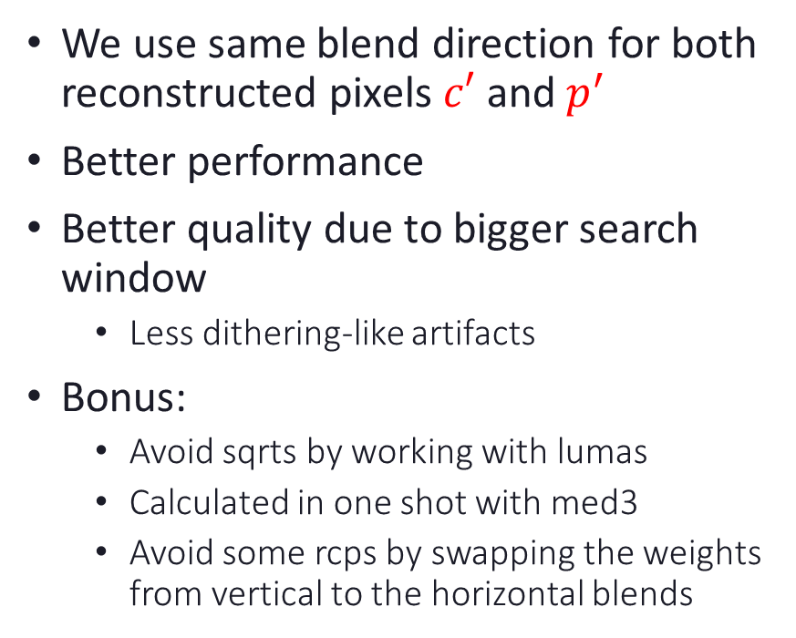
Shared Differential Blend
We use same blend direction for both reconstructed pixels $c′$ and $p^{′}$
Better performance
Better quality due to bigger search window
Less dithering-like artifacts
Bonus:
Avoid sqrts by working with lumas
Calculated in one shot with med3
Avoid some rcps by swapping the weights from vertical to the horizontal blends
float3 SMAADifferentialBlendCalculateWeight(float3 neighborhood1[4],
float3 neighborhood2[4])
{
float2 deltaH = float2(
SMAA_LUMA_FAST(abs(neighborhood1[SMAA_NEIGHBORHOOD_WEST] -
neighborhood1[SMAA_NEIGHBORHOOD_EAST])),
SMAA_LUMA_FAST(abs(neighborhood2[SMAA_NEIGHBORHOOD_WEST] -
neighborhood2[SMAA_NEIGHBORHOOD_EAST]))
);
float2 deltaV = float2(
SMAA_LUMA_FAST(abs(neighborhood1[SMAA_NEIGHBORHOOD_NORTH] -
neighborhood1[SMAA_NEIGHBORHOOD_SOUTH])),
SMAA_LUMA_FAST(abs(neighborhood2[SMAA_NEIGHBORHOOD_NORTH] -
neighborhood2[SMAA_NEIGHBORHOOD_SOUTH]))
);
float3 weights;
weights.xy = float2(
max(deltaV.x, 1e-3) * max(deltaV.y, 1e-3),
max(deltaH.x, 1e-3) * max(deltaH.y, 1e-3)
);
weights.z = rcp(weights.x + weights.y);
return weights;
}

Slide 43
[Berghoff2016] Checkerboard
Algorithm:
Render to EQAA spatial checkboard
Fills checkerboard with temporal information
If it fails, uses differential blend over the spatial checkerboard to fill missing pixels
Temporal and spatial reconstruction overlap, spatial one backs up temporal one
2x output
Our approach:
Render temporal checkerboard
Upsample horizontally using temporal information
Upsample vertically using spatial checkerboard reconstruction
4x output
Notes:
As a recap,
the core difference between Berghoff approach and ours
is that we use temporal upsampling and spatial reconstruction separately, for a net 4x output.
Berghoff uses the spatial reconstruction as a backup of temporal upsampling,
meaning a 2x output, which stands for different tradeoffs.

Slide 44
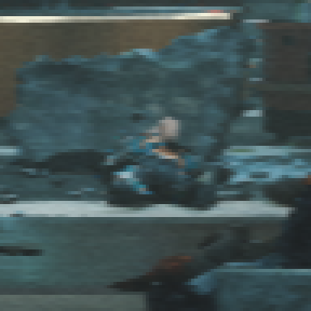
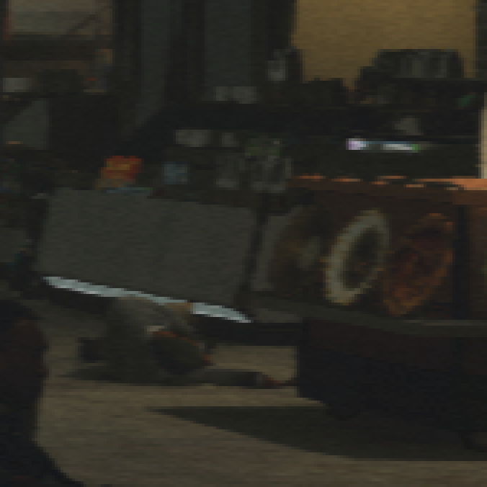
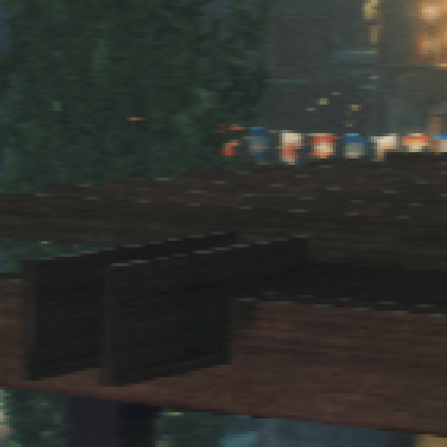
Dynamic Resolution + Bilinear Upsample

Slide 45
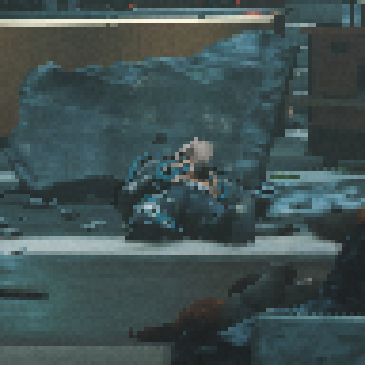
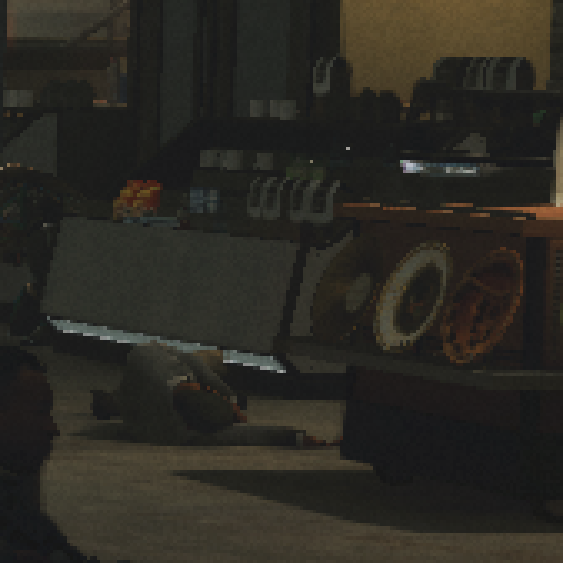
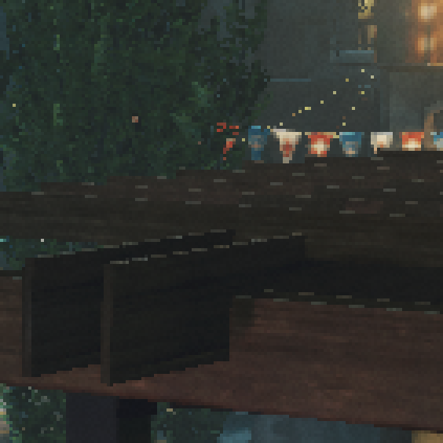
Filmic SMAA TU2x
Notes:
Here we have a comparison of TU2x…
[back and forth]
…with TU4x.
It can be seen how it is able not only to improve edges,
but to reconstruct subpixels, as can be seen on the right.

Slide 46
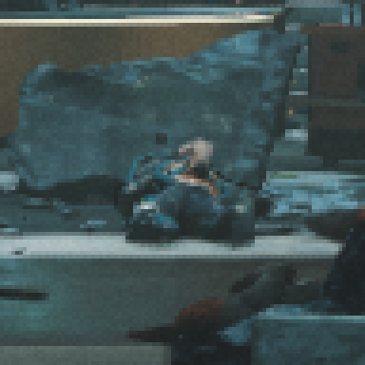
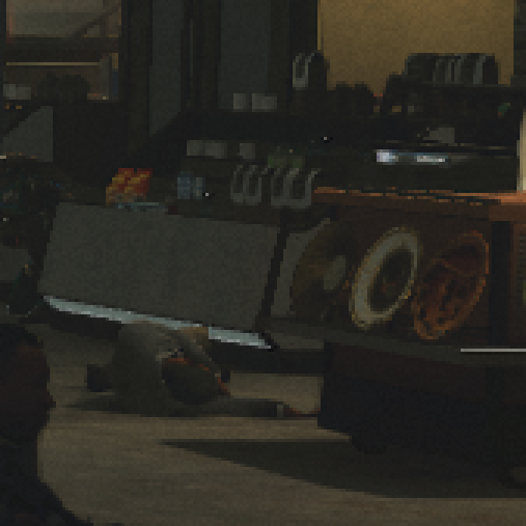
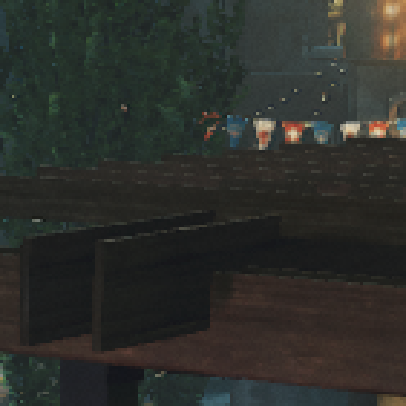
Filmic SMAA TU4x
Notes:
Here we have a comparison of TU2x…
[back and forth]
…with TU4x.
It can be seen how it is able not only to improve edges,
but to reconstruct subpixels, as can be seen on the right.

Slide 47
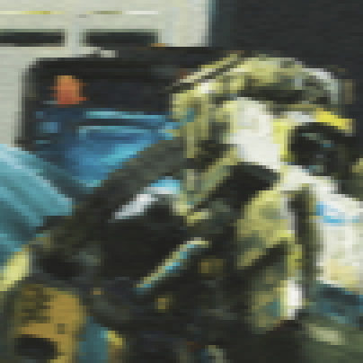
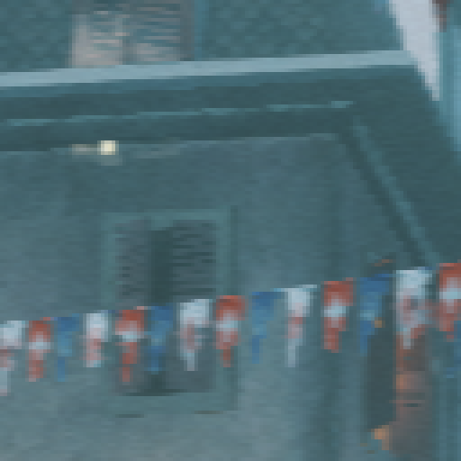
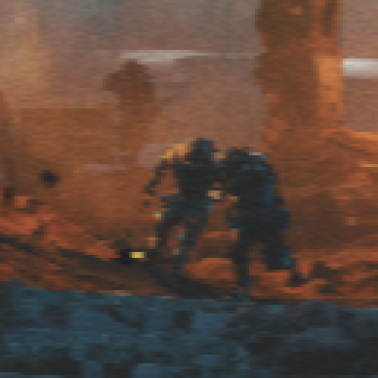
Dynamic Resolution + Bilinear Upsample

Slide 48
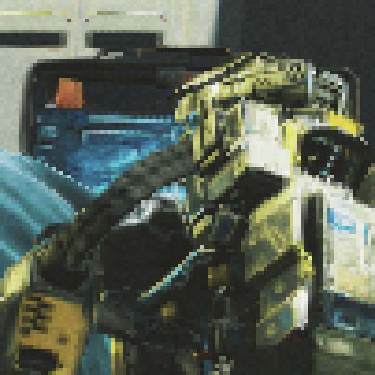
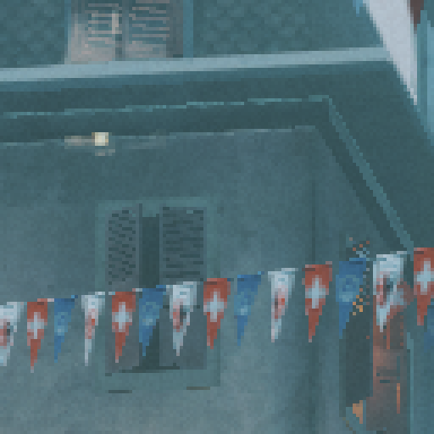
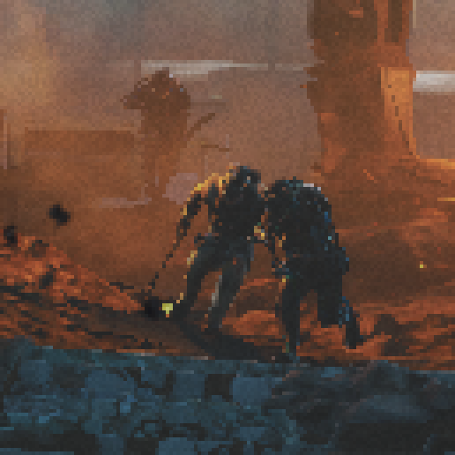
Filmic SMAA TU2x
Notes:
And here we have another example.

Slide 49

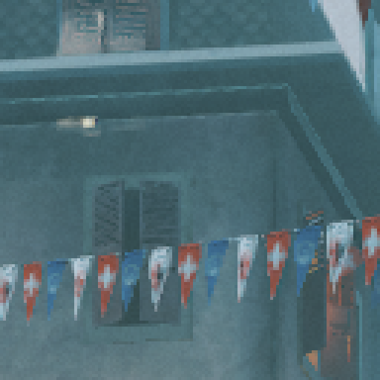
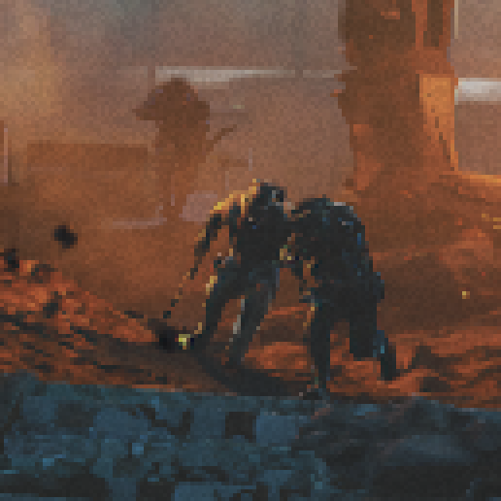
Filmic SMAA TU4x

Slide 50
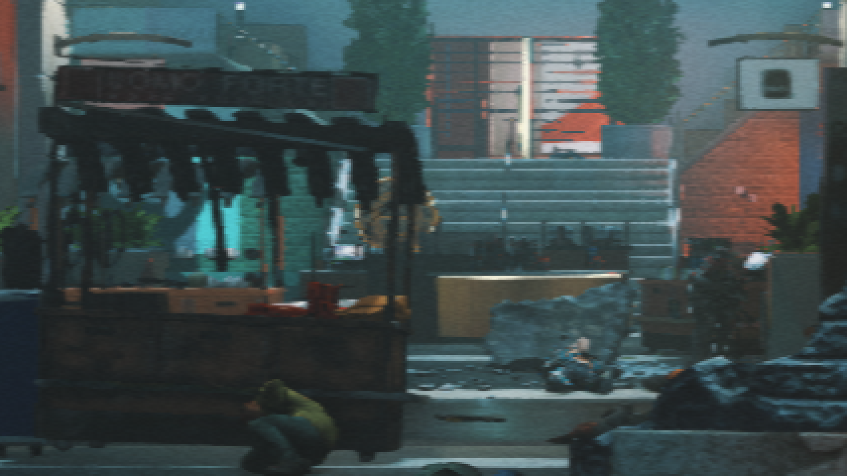
960x1080 + FXAA
© 2017 Activision Publishing, Inc.
Notes:
Let’s see some results.
This is the lowest dynamic resolution step, with no upsampler…

Slide 51
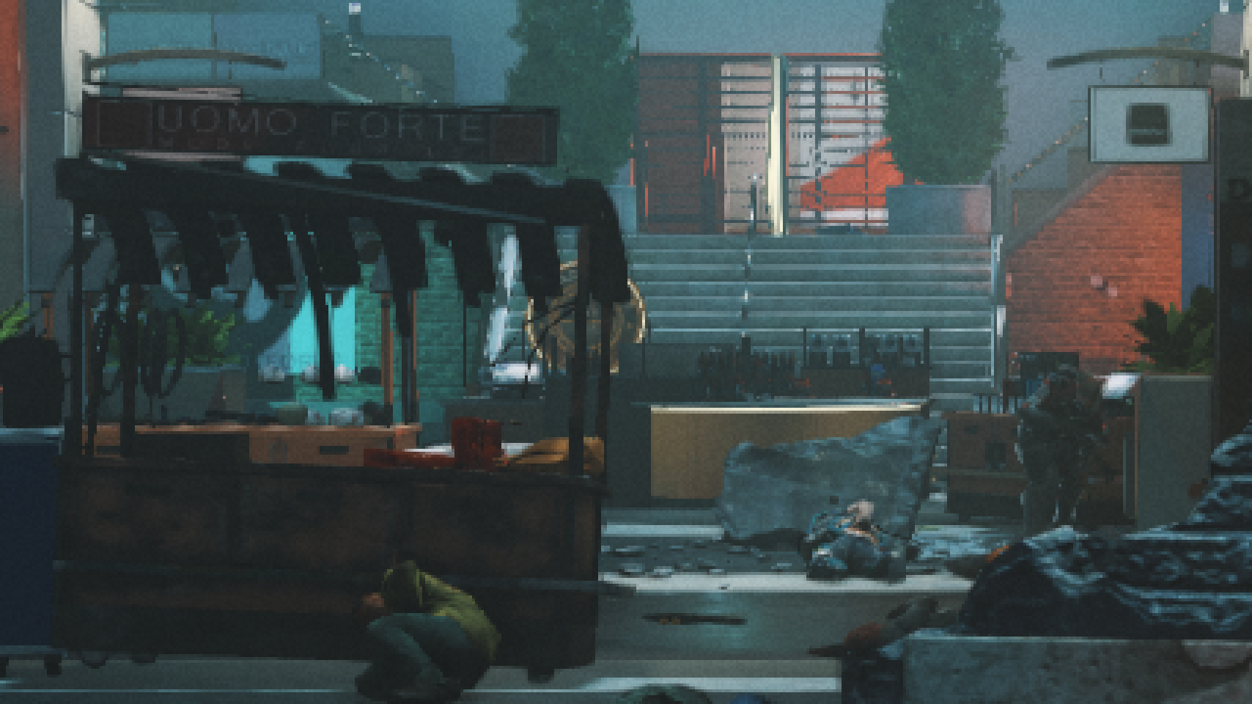
960x1080 + Filmic SMAA TU4x
© 2017 Activision Publishing, Inc.
Notes:
…and this is with the TU4x upsampler.

Slide 52
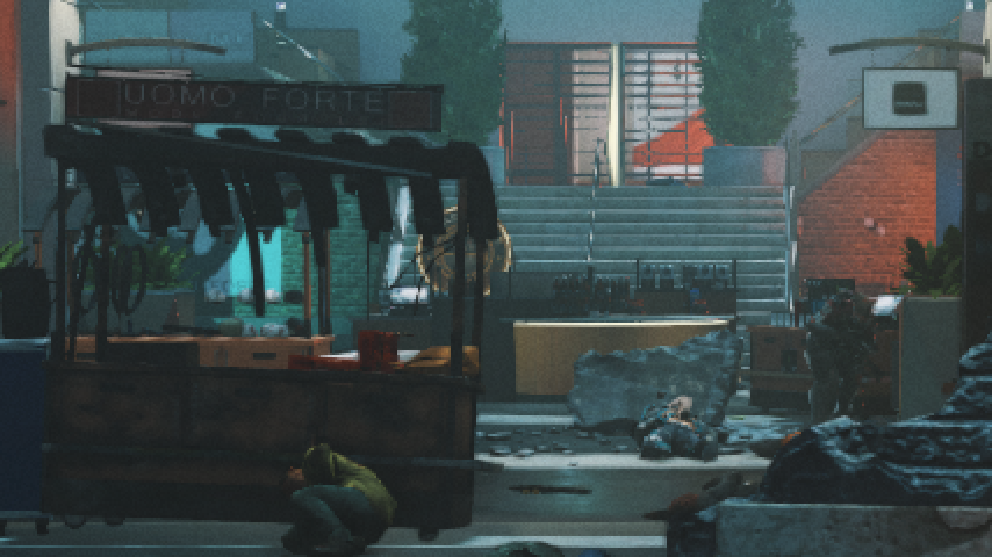
1440x1080 + Filmic SMAA TU4x
© 2017 Activision Publishing, Inc.
Notes:
This is an intermediate step…

Slide 53
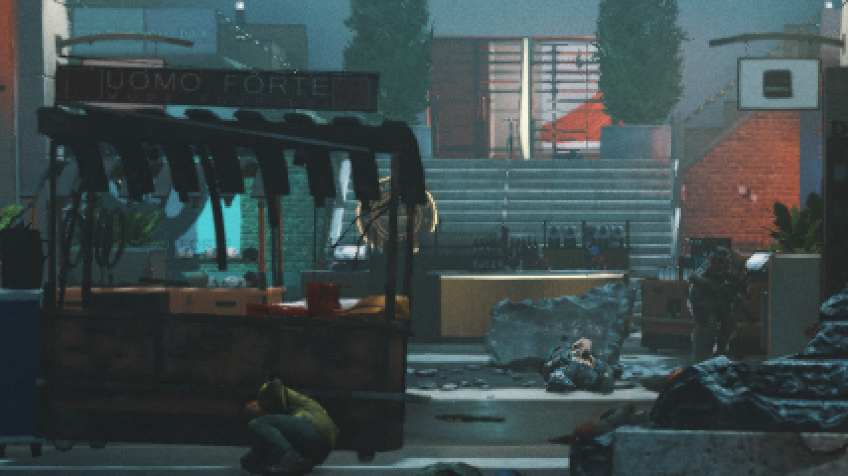
1920x1080 + Filmic SMAA T2x
© 2017 Activision Publishing, Inc.
Notes:
…and this the biggest dynamic resolution step, full HD.

Slide 54
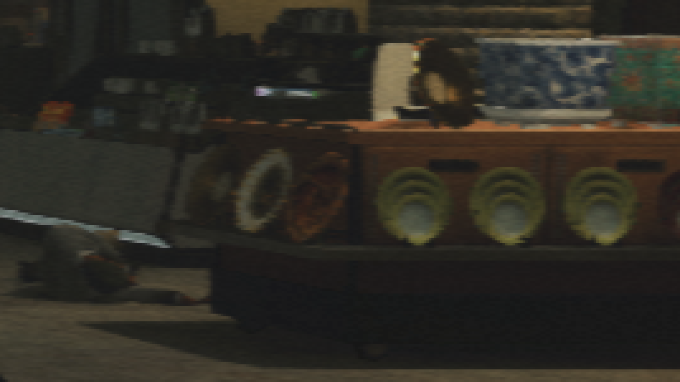
960x1080 + FXAA
© 2017 Activision Publishing, Inc.

Slide 55
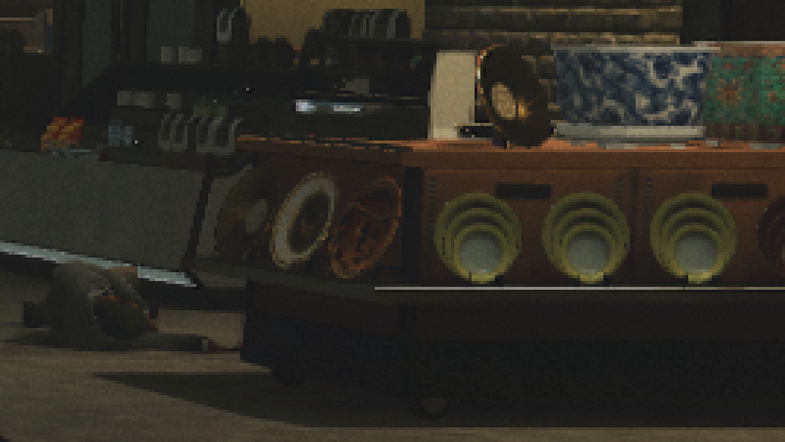
960x1080 + Filmic SMAA TU4x
© 2017 Activision Publishing, Inc.

Slide 56

1440x1080 + Filmic SMAA TU4x
© 2017 Activision Publishing, Inc.

Slide 57

1920x1080 + Filmic SMAA T2x
© 2017 Activision Publishing, Inc.

Slide 58
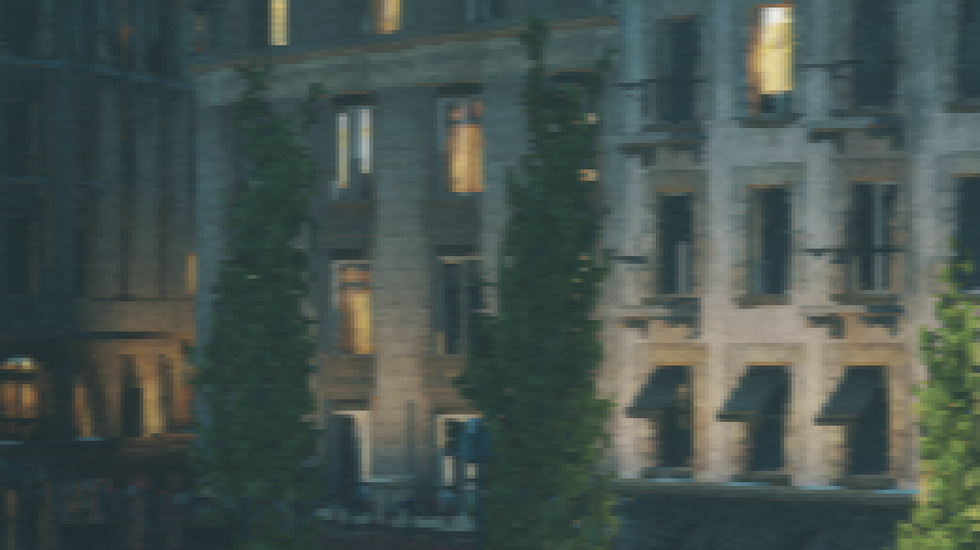
960x1080 + FXAA
© 2017 Activision Publishing, Inc.

Slide 59
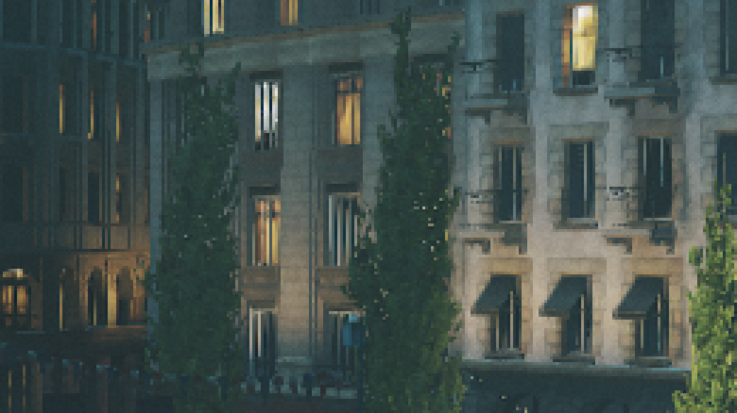
960x1080 + Filmic SMAA TU4x
© 2017 Activision Publishing, Inc.

Slide 60
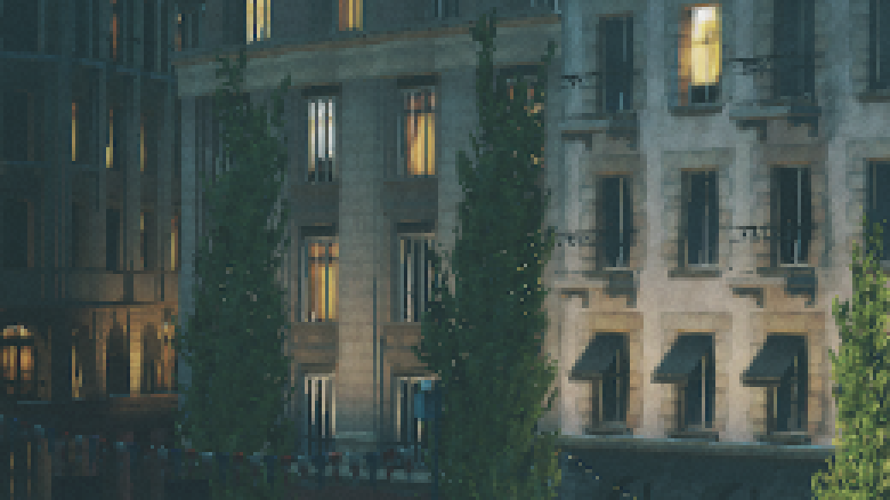
1440x1080 + Filmic SMAA TU4x
© 2017 Activision Publishing, Inc.

Slide 61

1920x1080 + Filmic SMAA T2x
© 2017 Activision Publishing, Inc.

Slide 62

960x1080 + FXAA
© 2017 Activision Publishing, Inc.

Slide 63

960x1080 + Filmic SMAA TU4x
© 2017 Activision Publishing, Inc.

Slide 64

1440x1080 + Filmic SMAA TU4x
© 2017 Activision Publishing, Inc.

Slide 65

1920x1080 + Filmic SMAA T2x
© 2017 Activision Publishing, Inc.

Slide 66

960x1080 + FXAA
© 2017 Activision Publishing, Inc.

Slide 67

960x1080 + Filmic SMAA TU4x
© 2017 Activision Publishing, Inc.

Slide 68

1440x1080 + Filmic SMAA TU4x
© 2017 Activision Publishing, Inc.

Slide 69

1920x1080 + Filmic SMAA T2x
© 2017 Activision Publishing, Inc.

Slide 70

960x1080 + FXAA
© 2017 Activision Publishing, Inc.

Slide 71

960x1080 + Filmic SMAA TU4x
© 2017 Activision Publishing, Inc.

Slide 72

1440x1080 + Filmic SMAA TU4x
© 2017 Activision Publishing, Inc.

Slide 73

1920x1080 + Filmic SMAA T2x
© 2017 Activision Publishing, Inc.

Slide 74

960x1080 + FXAA
© 2017 Activision Publishing, Inc.

Slide 75

960x1080 + Filmic SMAA TU4x
© 2017 Activision Publishing, Inc.

Slide 76

1440x1080 + Filmic SMAA TU4x
© 2017 Activision Publishing, Inc.

Slide 77

1920x1080 + Filmic SMAA T2x
© 2017 Activision Publishing, Inc.

Slide 78

960x1080 + FXAA
© 2017 Activision Publishing, Inc.

Slide 79

960x1080 + Filmic SMAA TU4x
© 2017 Activision Publishing, Inc.

Slide 80

1440x1080 + Filmic SMAA TU4x
© 2017 Activision Publishing, Inc.

Slide 81

1920x1080 + Filmic SMAA T2x
© 2017 Activision Publishing, Inc.

Slide 82

960x1080 + FXAA
© 2017 Activision Publishing, Inc.

Slide 83

960x1080 + Filmic SMAA TU4x
© 2017 Activision Publishing, Inc.

Slide 84

1440x1080 + Filmic SMAA TU4x
© 2017 Activision Publishing, Inc.

Slide 85

1920x1080 + Filmic SMAA T2x
© 2017 Activision Publishing, Inc.

Slide 86

960x1080 + FXAA
© 2017 Activision Publishing, Inc.

Slide 87

960x1080 + Filmic SMAA TU4x
© 2017 Activision Publishing, Inc.

Slide 88

1440x1080 + Filmic SMAA TU4x
© 2017 Activision Publishing, Inc.

Slide 89

1920x1080 + Filmic SMAA T2x
© 2017 Activision Publishing, Inc.

Slide 90

960x1080 + FXAA
© 2017 Activision Publishing, Inc.

Slide 91

960x1080 + Filmic SMAA TU4x
© 2017 Activision Publishing, Inc.

Slide 92

1440x1080 + Filmic SMAA TU4x
© 2017 Activision Publishing, Inc.

Slide 93

1920x1080 + Filmic SMAA T2x
© 2017 Activision Publishing, Inc.

Slide 94
4x Upsampler
Downsample (Average)
So far used for 2x vertical AA
Horizontal is dynamic bilinear as Dynamic AA 2x
Fixed vertical bilinear downsample
Full 4x output
Doubles state-of-the-art upsampler capabilities
Dynamic AA from 1920x1080 to 3840x2160 (with no bilinear upscale involved)
Full 4k pixels regardless of input resolution
2k texture details when starting from quarter res
4k texture details when starting from half res
Notes:
The technique presented so far performs a fixed vertical bilinear downsample.
But those samples can be output into individual pixels instead.
Or going further, same rationale used for the horizontal bilinear downsample
can be used here vertically,
for a full dynamic 4x output.
This means that for 4k we can do dynamic AA from 1k to 4k.
Let’s see that.

Slide 95
Dynamic Resolution
Output Size (4k)
Output Size (4k)
Light workload
Heavy workload
Notes:
Remember that dynamic resolution changed output resolution
depending on workload
as shown in this slide.

Slide 96
2x Upsampler
Output Size (4k)
Output Size (4k)
Light workload
Heavy workload
Notes:
So, if the 2x upsampler was doing this…

Slide 97
4x Upsampler
Output Size (4k)
Output Size (4k)
1k
Heavy workload
Light workload
Notes:
…the 4x upsampler will do this instead.
As we can see on the right,
in the worst dynamic resolution case, we will be rendering a 1k scene,
and upsampling it to 4k individual pixels.
So, let’s see how it looks like in this worst case scenario.

Slide 98



Results
No upsampling
Notes:
Here we have there images without temporal upsampling…

Slide 99



Results
Filmic SMAA TU2x
(Morphological removed to see upsampling effect in isolation)
Notes:
…here with 2x upsampling.
Notice the increased horizontal resolution.
[go back and forth]

Slide 100



Results
Filmic SMAA TU4x
(Morphological removed to see upsampling effect in isolation)
Notes:
And here we have with 4x upsampling,
where we can observe increased vertical resolution as well.
[go back and forth]

Slide 101
Results
No upsampling
Notes:
If we switch back to no upsampling, we can see the full effect.
[go back and forth]

Slide 102

New Temporal Toolset
© 2017 Activision Publishing, Inc.
Notes:
The next part is the new temporal toolset.
So far we have increased the quality,
but in that process we also made our antialiasing shader more expensive,
so it was time for optimization.

Slide 103

1-Sample Spatio-Temporal Bicubic Resampling Intro
History buffer resampling leads to numerical diffusion error
Manifests as blur
Notes:
Temporal antialiasing techniques typically use exponential history buffers
to obtain information from previous frames.
Reprojecting the pixel position
to fetch the history buffer
leads to numerical diffusion error,
which manifests as blur.

Slide 104

1-Sample Spatio-Temporal Bicubic Resampling Intro
History buffer resampling leads to numerical diffusion error
Manifests as blur
Bicubic filtering mitigates this problem [Jimenez2016]
Notes:
The good news are that simply using bicubic filtering mitigates this issue,
as we shown in our previous work.

Slide 105

Notes:
To show how severe is this issue, let me show this movie.
[click]
Red is with bilinear filtering, and green is bicubic.

Slide 106
5-Sample Bicubic Resampling [Jimenez2016]
Bilinear access
Optimized Catmull-Rom uses 9 bilinear samples to filter the 4x4 area
http://vec3.ca/bicubic-filtering-in-fewer-taps/
http://http.developer.nvidia.com/GPUGems2/gpugems2_chapter20.html
(-1,-1)
(0,0)
(2,2)
Notes:
The bad news are that bicubic filtering is too expensive.
Here we have the standard 9 sample bicubic implementation.

Slide 107
5-Sample Bicubic Resampling [Jimenez2016]
Ignoring the 4 corners yields very similar results
Reduces from 9 to 5 samples
(-1,-1)
(0,0)
(2,2)
Notes:
And here is what we proposed in 2016.
Removing the corners of the filter
allows to reduce from 9 to 5 samples with little quality loss.
But, we wanted something faster.
From now on, I’ll refer to this approach as the 5-sample bicubic filter.

Slide 108

Bicubic Resampling
Mitchell-Netravali bicubic equation is computationally expensive:
$$f\left(x\right)=\left\{\begin{aligned}\left(12−9B−6C\right){\left|x\right|}^{3}+\left(−18+12B+6C\right){\left|x\right|}^{2}+\left(6−2B\right),\left|x\right|<1 \\ \left(−B−6C\right){\left|x\right|}^{3}+\left(6B+30C\right){\left|x\right|}^{2}+\left(−12B−48C\right)x+(8B+24C), 1≤\left|x\right|≤2 \\ 0, otherwise\end{aligned}\right.$$
Temporal effects are more forgiving than spatial ones with respect to quality
What is really needed for temporal resampling?
Spatio-Temporal Optimization
Computation Optimization
Notes:
If we take a look to Mitchell-Netravali equation, which is one of the options for bicubic filtering,
we can see that it is computationally expensive.
No doubt we need this for spatial filters, but temporal effects are more forgiving.
So, what is really needed for temporal resampling?
To answer that, we will present two optimizations in the next few slides.

Slide 109


Spatio-Temporal Optimization
The color information for the 5-sample bicubic is the following:
History color at texture coordinate
$h_{m}$
History color neighborhood around texture coordinate
$h_{w}$
$h_{e}$
$h_{n}$
$h_{s}$
Idea: perform bicubic filtering across time
Notes:
First one, is a spatio-temporal optimization.
To explain it, let me recap the information needed for the 5-sample bicubic, which is:
the history color at the reprojected texture coordinate,
marked on blue
and its color neighborhood,
marked on orange.

Slide 110

Spatio-Temporal Optimization
The color information for the 5-sample bicubic is the following:
History color at texture coordinate
$h_{m}$
History color neighborhood around texture coordinate
$h_{w}$
$h_{e}$
$h_{n}$
$h_{s}$
Idea: perform bicubic filtering across time
Notes:
So, the idea is to perform bicubic filtering across time,
rather than on the space domain.

Slide 111


Spatio-Temporal Optimization
Estimate history neighborhood colors $h$with current frame colors $c$:
$h_{w}≈$ $h_{m}+(c_{w}−c_{m})$
$h_{e}≈h_{m}+(c_{e}−c_{m})$
$h_{n}≈h_{m}+(c_{n}−c_{m})$
$h_{s}≈h_{m}+(c_{s}−c_{m})$
We already have them for the neighborhood clamp
Very good match if reprojecting inside of an object
On edges they will be different
Slightly reintroduces some aliasing
But much sharper details
It actually brings back real details rather than sharpening the history buffer
1-sample spatio-temporal bicubic -> we just sample $h_{m}$
Notes:
For that, we estimate the history neighborhood colors, in orange,
with the current frame colors, in green.
Note that these colors are typically available in temporal antialiasing shaders,
as they are needed for the neighborhood clamp heuristic used to combat ghosting.
So, they are free in this context.
This means that we only need one sample
for the spatio-temporal bicubic filter.
This has some implications, that we will explain later on.

Slide 112
Computation Optimization
float3 SMAABicubicFilter(SMAATexture2D colorTex, float2 texcoord, float4 rtMetrics)
{
float2 position = rtMetrics.zw * texcoord;
float2 centerPosition = floor(position - 0.5) + 0.5;
float2 f = position - centerPosition;
float2 f2 = f * f;
float2 f3 = f * f2;
float c = SMAA_FILMIC_REPROJECTION_SHARPNESS / 100.0;
float2 w0 = -c * f3 + 2.0 * c * f2 - c * f;
float2 w1 = (2.0 - c) * f3 - (3.0 - c) * f2 + 1.0;
float2 w2 = -(2.0 - c) * f3 + (3.0 - 2.0 * c) * f2 + c * f;
float2 w3 = c * f3 - c * f2;
float2 w12 = w1 + w2;
float2 tc12 = rtMetrics.xy * (centerPosition + w2 / w12);
float3 centerColor = SMAASample(colorTex, float2(tc12.x, tc12.y)).rgb;
float2 tc0 = rtMetrics.xy * (centerPosition - 1.0);
float2 tc3 = rtMetrics.xy * (centerPosition + 2.0);
float4 color = float4(SMAASample(colorTex, float2(tc12.x, tc0.y )).rgb, 1.0) * (w12.x * w0.y ) +
float4(SMAASample(colorTex, float2(tc0.x, tc12.y)).rgb, 1.0) * (w0.x * w12.y) +
float4(centerColor, 1.0) * (w12.x * w12.y) +
float4(SMAASample(colorTex, float2(tc3.x, tc12.y)).rgb, 1.0) * (w3.x * w12.y) +
float4(SMAASample(colorTex, float2(tc12.x, tc3.y )).rgb, 1.0) * (w12.x * w3.y );
return color.rgb * rcp(color.a);
}
[Jimenez2016]
Notes:
Now to the computation optimization.
Here we have the code for the 5-sample bicubic filter that we shown in 2016.

Slide 113
Computation Optimization
float3 SMAABicubicFilter(SMAATexture2D colorTex, float2 texcoord, float4 rtMetrics)
{
float2 position = rtMetrics.zw * texcoord;
float2 centerPosition = floor(position - 0.5) + 0.5;
float2 f = position - centerPosition;
float2 f2 = f * f;
float2 f3 = f * f2;
float c = SMAA_FILMIC_REPROJECTION_SHARPNESS / 100.0;
float2 w0 = -c * f3 + 2.0 * c * f2 - c * f;
float2 w1 = (2.0 - c) * f3 - (3.0 - c) * f2 + 1.0;
float2 w2 = -(2.0 - c) * f3 + (3.0 - 2.0 * c) * f2 + c * f;
float2 w3 = c * f3 - c * f2;
float2 w12 = w1 + w2;
float2 tc12 = rtMetrics.xy * (centerPosition + w2 / w12);
float3 centerColor = SMAASample(colorTex, float2(tc12.x, tc12.y)).rgb;
float2 tc0 = rtMetrics.xy * (centerPosition - 1.0);
float2 tc3 = rtMetrics.xy * (centerPosition + 2.0);
float4 color = float4(SMAASample(colorTex, float2(tc12.x, tc0.y )).rgb, 1.0) * (w12.x * w0.y ) +
float4(SMAASample(colorTex, float2(tc0.x, tc12.y)).rgb, 1.0) * (w0.x * w12.y) +
float4(centerColor, 1.0) * (w12.x * w12.y) +
float4(SMAASample(colorTex, float2(tc3.x, tc12.y)).rgb, 1.0) * (w3.x * w12.y) +
float4(SMAASample(colorTex, float2(tc12.x, tc3.y )).rgb, 1.0) * (w12.x * w3.y );
return color.rgb * rcp(color.a);
}
[Jimenez2016]
Notes:
But ignore everything
and just look at the end of the code, marked on red.
It is just a weighted average,
where each of the 5 samples get a unique weight.

Slide 114
Computation Optimization
float4 color = float4(SMAASample(colorTex, float2(tc12.x, tc0.y )).rgb, 1.0) * (w12.x * w0.y ) +
float4(SMAASample(colorTex, float2(tc0.x, tc12.y)).rgb, 1.0) * (w0.x * w12.y) +
float4(centerColor, 1.0) * (w12.x * w12.y) +
float4(SMAASample(colorTex, float2(tc3.x, tc12.y)).rgb, 1.0) * (w3.x * w12.y) +
float4(SMAASample(colorTex, float2(tc12.x, tc3.y )).rgb, 1.0) * (w12.x * w3.y );
return color.rgb * rcp(color.a);
Notes:
Let me take this piece of the code apart,
to keep the attention where we need to,
which is this weighted average.

Slide 115
Computation Optimization
float4 color =
float4(SMAASample(colorTex, float2(tc0.x, tc12.y)).rgb, 1.0) * w0.x +
float4(centerColor, 1.0) * w12.x +
float4(SMAASample(colorTex, float2(tc3.x, tc12.y)).rgb, 1.0) * w3.x +
return color.rgb * rcp(color.a);
Notes:
And then reduce the problem to one dimension to simplify the analysis.
Here I’ve just removed the vertical samples and weights.
So, this is just a weighted average of the center pixel
and the pixels on the left and right.
Note that the center color is multiplied by w12.

Slide 116
Computation Optimization
float4 color =
float4(SMAASample(colorTex, float2(tc0.x, tc12.y)).rgb, 1.0) * (w0.x / w12.x) +
float4(centerColor, 1.0) * (w12.x / w12.x) +
float4(SMAASample(colorTex, float2(tc3.x, tc12.y)).rgb, 1.0) * (w3.x / w12.x) +
return color.rgb * rcp(color.a);
Notes:
If we divide all three samples by this…

Slide 117
Computation Optimization
float4 color =
float4(SMAASample(colorTex, float2(tc0.x, tc12.y)).rgb, 1.0) * (w0.x / w12.x) +
float4(centerColor, 1.0) * 1.0 +
float4(SMAASample(colorTex, float2(tc3.x, tc12.y)).rgb, 1.0) * (w3.x / w12.x) +
return color.rgb * rcp(color.a);
Notes:
…we have a fixed weight of 1 for the center color, marked in green here.

Slide 118
Computation Optimization
float4 color =
float4(SMAASample(colorTex, float2(tc0.x, tc12.y)).rgb, 1.0) * (w0.x / w12.x) +
float4(centerColor, 1.0) * 1.0 +
float4(SMAASample(colorTex, float2(tc3.x, tc12.y)).rgb, 1.0) * (w3.x / w12.x) +
return color.rgb * rcp(color.a);
Notes:
Then we have the weights for the left and right pixels on blue and orange.

Slide 119

Computation Optimization
float4 color =
float4(SMAASample(colorTex, float2(tc0.x, tc12.y)).rgb, 1.0) * (w0.x / w12.x) +
float4(centerColor, 1.0) * 1.0 +
float4(SMAASample(colorTex, float2(tc3.x, tc12.y)).rgb, 1.0) * (w3.x / w12.x) +
return color.rgb * rcp(color.a);
x
Left Pixel
Right Pixel
Notes:
So, just to recap what we have so far, we are interpolating between the gray pixels,
using the fractional x,
and the assistance of the blue and orange pixels.
Now, let’s plot how the weight for the left pixel looks like.

Slide 120



Plotting the weights (left pixel): $m_{0}$
$m_{0}(x)=w_{0}(x)/w_{12}(x)\text{=}\frac{x(1+\left(x−2\right)x) }{(x−1) x−1}$
x
0
1
x
Left Pixel
Right Pixel
Weight
for left pixel
Notes:
We can see how the sharpening, negative weight,
increases as the fractional of the position
becomes closer to the left pixel,
or zero in the x axis in this figure.

Slide 121



Plotting the weights (right pixel): $m_{3}$
$m_{3}(x)=w_{3}(x)/w_{12}(x)\text{=}\frac{(1−x) x}{(x−1) x−1}$
x
0
1
x
Left Pixel
Right Pixel
Weight
for right pixel
Notes:
Then we have the same for the right pixel,
meaning a symmetrical behavior, as expected.
This means that the closer to the left or right pixels,
the more sharpening effect we get.

Slide 122



Plotting the weights: $m_{03}\left(x\right)$
Assumption:
Left and right colors are the same
Single weight:
$$m_{03}\left(x\right)=m_{0}\left(x\right)+m_{3}\left(x\right)$$
Notes:
Now let’s do the assumption that left and right colors are the same,
so we can just pick one of them and apply a single weight.
In that case, the shape is simpler…

Slide 123



Plotting the weights: $m_{03}′\left(x\right)$
Which can be fitted:
$$m_{03}^{′}(x)\text{= }x(0.8x−0.8)$$
Notes:
…and we could do a fitting for a simpler expression,
that can be executed in only two instructions.

Slide 124
Insight 1
Why bicubic filtering works so well for temporal resampling?
When fractional of the position is near 0.5:
Maximum numerical diffusion error (blurriest)
Bicubic filtering sharpens the most
Maximum diffusion error
Maximum sharpening
Notes:
Looking at bicubic into this degree of detail
allow us to make two insights.
One of the reasons for bicubic filtering to work so well for temporal resampling
is that when the numerical diffusion error is potentially maximum,
bicubic sharpens the most,
which is clear looking at this figure.

Slide 125
Insight 2
Bicubic can be seen as:
Directional unsharp mask
Sharpness dependent on fractional of position
Direction dependent on the fractional of the position
Notes:
The second insight
is that bicubic can be seen as a directional unsharp mask,
with the sharpness and direction
dependent on the fractional of the position.
We have handled the sharpness amount but not the direction,
given that we have made the assumption of left and right pixels being the same.

Slide 126


Handling the direction
We made the assumption of left and right colors being the same
When this assumption does not hold, they are pulled asymmetrically
Left
Right
Notes:
When this assumption does not hold,
the left and right pixels are pulled asymmetrically,
meaning that they have different weights.

Slide 127



Handling the direction
0.25
$$x$$
Looking at relative weights for left and right, we can observe the following from the fractional $x$:
If$x=0.25$: $\text{left}=\text{2.5 }×\text{right}$
If $x=0.5$: left $=$ right
If$x=0.75$: $\text{right}=\text{2.5 }× \text{left}$
Linear?
left
$$x$$
right
Notes:
Let’s see how much the left and right pixels contribute.
For example if the fractional is 0.25,
we can see that the left pixel is 2 times and half bigger than the right one.

Slide 128

Handling the direction
0.5
$$x$$
Looking at relative weights for left and right, we can observe the following from the fractional $x$:
If$x=0.25$: $\text{left}=\text{2.5 }×\text{right}$
If $x=0.5$: left $=$ right
If$x=0.75$: $\text{right}=\text{2.5 }× \text{left}$
Linear?
left
$$x$$
right
Notes:
If the fractional is 0.5, left and right contribute in the same amount.

Slide 129

Handling the direction
0.75
$$x$$
left
Looking at relative weights for left and right, we can observe the following from the fractional $x$:
If$x=0.25$: $\text{left}=\text{2}\text{.5 }×\text{right}$
If $x=0.5$: left $=$ right
If$x=0.75$: $\text{right}=\text{2.5 }× \text{left}$
Linear?
$$x$$
right
Notes:
Finally, if we look at fractional 0.75,
the right pixel is 2 times and half bigger than the left one.
From this observations,
it seems like the weights for the left and right pixels
are linear with respect to the fractional of the position.

Slide 130




Handling the direction
Plotting $y=\frac{m_{0}(x)}{m_{0}\left(x\right) + m_{3}(x)}$ confirmed linearity
Just calculate blended color with a lerp over the fractional $x$
color = lerp( left, right, x )
$$y$$
$$x$$
Notes:
Plotting the relative weight for the left versus the right pixel,
we confirmed our observations.
By the end of the day,
this means that we can just calculate a blended color as input for our simplified Bicubic filter,
which until this slide didn’t consider directionality.

Slide 131

Summary
We went from the computationally expensive Mitchell-Netravali Bicubic equation:
$$f\left(x\right)=\left\{\begin{aligned}\left(12−9B−6C\right){\left|x\right|}^{3}+\left(−18+12B+6C\right){\left|x\right|}^{2}+\left(6−2B\right),\left|x\right|<1 \\ \left(−B−6C\right){\left|x\right|}^{3}+\left(6B+30C\right){\left|x\right|}^{2}+\left(−12B−48C\right)x+(8B+24C), 1≤\left|x\right|≤2 \\ 0, otherwise\end{aligned}\right.$$
To this simple shader snippet:
m03 = x * ( 0.8 * x - 0.8 )
color = lerp( left, right, x )
filteredColor = ( m03 * color + 1.0 * historyColor ) / ( m03 + 1.0 )
Notes:
So, to summarize our contribution,
we went from the expensive Mitchell-Netravali Bicubic equation…

Slide 132

Summary
We went from the computationally expensive Mitchell-Netravali Bicubic equation:
$$f\left(x\right)=\left\{\begin{aligned}\left(12−9B−6C\right){\left|x\right|}^{3}+\left(−18+12B+6C\right){\left|x\right|}^{2}+\left(6−2B\right),\left|x\right|<1 \\ \left(−B−6C\right){\left|x\right|}^{3}+\left(6B+30C\right){\left|x\right|}^{2}+\left(−12B−48C\right)x+(8B+24C), 1≤\left|x\right|≤2 \\ 0, otherwise\end{aligned}\right.$$
To this simple shader snippet:
m03 = x * ( 0.8 * x - 0.8 )
color = lerp( left, right, x )
filteredColor = ( m03 * color + 1.0 * historyColor ) / ( m03 + 1.0 )
Notes:
…to this simple shader snippet,
which executes much faster.

Slide 133
1-Sample Spatio-Temporal Bicubic Filtering Shader Code
float3 SMAABicubicFilter(float3 currentNeighborhood[4], float3 currentCenterColor, float3 previousCenterColor,
float2 texcoord, float4 rtMetrics, float sharpnessScale)
{
float2 f = frac(rtMetrics.zw * texcoord - 0.5);
float c = 0.8 * sharpnessScale * SMAA_FILMIC_REPROJECTION_SHARPNESS / 100.0;
float2 w = c * (f * f - f);
#if SMAA_REFERENCE_CODE
float3 currentColorH = lerp(currentNeighborhood[SMAA_NEIGHBORHOOD_WEST], currentNeighborhood[SMAA_NEIGHBORHOOD_EAST], f.x);
float3 currentColorV = lerp(currentNeighborhood[SMAA_NEIGHBORHOOD_NORTH], currentNeighborhood[SMAA_NEIGHBORHOOD_SOUTH], f.y);
float4 color = float4(previousCenterColor + currentColorH - currentCenterColor, 1.0) * w.x +
float4(previousCenterColor + currentColorV - currentCenterColor, 1.0) * w.y +
float4(previousCenterColor, 1.0);
#else
float4 color = float4(lerp(currentNeighborhood[SMAA_NEIGHBORHOOD_WEST], currentNeighborhood[SMAA_NEIGHBORHOOD_EAST], f.x), 1.0) * w.x +
float4(lerp(currentNeighborhood[SMAA_NEIGHBORHOOD_NORTH], currentNeighborhood[SMAA_NEIGHBORHOOD_SOUTH], f.y), 1.0) * w.y;
color += float4((1.0 + color.a) * previousCenterColor - color.a * currentCenterColor, 1.0);
#endif
return color.rgb * rcp(color.a);
}

Slide 134
Shader Code Statistics
9-sample spatial bicubic:
Vector ALU: 78
Vector memory: 9
Estimated cost (cycles): 1868
5-sample spatial bicubic:
Vector ALU: 69
Vector memory: 4 + 1 already available
Estimated cost (cycles): 978 (1.91x)
1-sample spatio-temporal bicubic:
Vector ALU: 51
Vector memory: 1 + 4 already available
Estimated cost (cycles): 372 (5x)
Notes:
To show that, here we have some shader code statistics,
where we can see that the new 1-sample bicubic is
5 times faster than the original 9-sample one.

Slide 135

Notes:
This movie compares the 9-sample Bicubic (red) with our proposed approach (green).

Slide 136




Results
9-Sample Bicubic Resampling
Notes:
In terms of quality,
we noticed that our 1-sample bicubic filter yields sharper results,
and recovers true detail that the regular bicubic filter is not able to.

Slide 137




Results
Our 1-Sample Spatio-Temporal Bicubic Resampling
Notes:
[back and forth]
The reason is that standard bicubic filtering sharpens
using data from the blurry history buffer,
where details are already gone.
But our new filter applies the unsharp mask using fresh current frame information.
This has the implication of creating sharper, more detailed images,
at the cost of slightly reintroducing aliasing.
But we have found the tradeoff to generally be favorable to this new technique.

Slide 138

1x Antialiasing Dynamics
Notes:
The next tool is the dynamic subpixel jittering.
But before we go into that, let me show you something [click].
We’re looking at no antialiasing.
But if you look at the vertical edge, it appears antialiased,
specially in comparison with the horizontal one.
But notice that, as soon as we stop the motion, the antialiasing disappears.
So, let’s figure out this mystery.

Slide 139

Dynamic Subpixel Jittering
1x antialiasing subpixel landing for 0.25px velocity sequence
Notes:
Here we have 1x antialiasing, with an object moving at 0.25 pixel steps.

Slide 140

Dynamic Subpixel Jittering
1x antialiasing subpixel landing for 0.25px velocity sequence
Good
(5 samples)
Notes:
Now on the right, I put apart what a pixel sees over time.
We can observe the subpixel positions landed by the object,
which are pretty good:
we got 5 different positions or subsamples.
This is what happened in the movie I just shown.
The object was landing in different and evenly spaced subpixel positions,
and given the high framerate
we were perceiving this as antialiasing.
Our eyes and the panel of the screen
will blend consecutive frames if the framerate is high enough.

Slide 141


Dynamic Subpixel Jittering
1x antialiasing subpixel landing for 0.5px velocity sequence
Good
(3 samples)
Notes:
Now let’s see what happens with 0.5 pixel steps.
It’s still good, we got two unique subpixel features.

Slide 142

Dynamic Subpixel Jittering
1x antialiasing subpixel landing for 0.75px velocity sequence
Good
(5 samples)
Notes:
Then 0.75 steps.
Still pretty good.

Slide 143


Dynamic Subpixel Jittering
1x antialiasing subpixel landing for 1px velocity sequence
Bad
(1 sample)
Notes:
Now 1 pixel steps.
This is where problems appear,
we’re just sampling one subpixel position over time.

Slide 144

Temporal 2x Antialiasing Dynamics
Notes:
Now let’s do the same but with temporal 2x [click].
On static images, it looks like regular supersampling 2x.
But in motion, notice how the supersampling quality radically improves…
until it reverts back to no aa.
Then it cycles back to very high quality.
[Note: no temporal filtering (exponential accumulation buffer) is being applied, we are just blending two consecutive frames]

Slide 145


Dynamic Subpixel Jittering
Temporal 2x antialiasing subpixel landing for a static image
Odd Frame Jitter
Even Frame Jitter
Good
(2 samples)

Slide 146

Dynamic Subpixel Jittering
Temporal 2x antialiasing subpixel landing for 1px velocity sequence
Odd Frame Jitter
Even Frame Jitter
Good
(2 samples)
Notes:
Let’s do the same analysis for temporal 2x.
In this case we switch the jitter per frame, marked in blue and orange.
If we look at the subpixel positions visited over time, on the right,
they are quite good for the case of moving in 1 pixel steps…

Slide 147
Dynamic Subpixel Jittering
1x antialiasing subpixel landing for 1px velocity sequence
Bad
(1 sample)
Notes:
…which let me remind was the case where 1x antialiasing was misbehaving [back and forth].

Slide 148


Dynamic Subpixel Jittering
Temporal 2x antialiasing subpixel landing for 0.5px velocity sequence
Odd Frame Jitter
Even Frame Jitter
Bad
(1 sample)
Notes:
But now let’s see what happens for 0.5 pixel steps.
Notice that we’re always sampling in the same subpixel position over time.
This is why we seen it loses antialiasing at a given speed,
and why it recovered when moving faster.
This is a cyclic problem.

Slide 149
Dynamic Subpixel Jittering
1x antialiasing subpixel landing for 0.5px velocity sequence
Good
(3 samples)
Notes:
But see how this same velocity was creating great results for the 1x case [back and forth].
So, we have a pattern here.
When 1x fails 2x works well.
When 2x fails 1x works great.

Slide 150

Dynamic Subpixel Jittering
Idea: alter subpixel position on the vertex shader according to velocity
float2 scale = 0.5f + 0.5f *
cos((3.141592f / jitterDistance) *
velocity);
svPosition.xy += scale * jitter.xy * svPosition.w;
Notes:
So at this point, you can imagine in which consists the dynamic subpixel jittering idea,
which is to alter the subpixel position according to the velocity,
cycling from 1x to 2x
to correct for the aliasing created by those patterns at given speeds.

Slide 151


Dynamic Subpixel Jittering
Idea: alter subpixel position according to velocity on the vertex shader:
Velocity $\sim$0.5px: no jitter
float2 scale = 0.5f + 0.5f *
cos((3.141592f / jitterDistance) *
velocity);
svPosition.xy += scale * jitter.xy * svPosition.w;
Notes:
If the fractional of the velocity is close to 0.5 pixels,
we don’t apply any jitter,
as 1x works great…

Slide 152


Dynamic Subpixel Jittering
Idea: alter subpixel position according to velocity on the vertex shader:
Velocity $\sim$0.5px: no jitter
Velocity $\sim$1px: 2x jitter
float2 scale = 0.5f + 0.5f *
cos((3.141592f / jitterDistance) *
velocity);
svPosition.xy += scale * jitter.xy * svPosition.w;
Notes:
And if it is close to 1 pixel, we apply 2x jitter.

Slide 153

Dynamic Subpixel Jittering (On vs. Off)
Notes:
Let’s see how it looks like in motion.

Slide 154

Dynamic Subpixel Jittering (On vs. Halton16)
Notes:
This problem also affects Halton sequences of 16 subsamples,
which the standard for many temporal AA implementations,
even if does in a lesser degree.
So let’s see that [click]
Here we were comparing 16 temporal subsamples using Halton, on red,
versus using only 2 at the right places, on green.

Slide 155
Insight
Sequences of 16x Halton offsets are not necessarily better than 1x nor 2x jittering in motion
Optimal sampling scheme depends on velocity
Notes:
The take away here
is that more temporal subsamples
not always results in higher quality antialiasing.
The optimal sampling scheme
depends ultimately on the velocity of the sampled object.

Slide 156


Fast Temporal Wide Resolves
Current Frame Neighborhood
Dropped Adaptive Quincunx [Jimenez2016] for wider resolves
Rotated wide resolve minimizes samples needed (extends Quincunx)
2px wide resolve (from Quincunx’s 1.414px)
Quincunx
1.414px wide
Rotated 3x3 Wide Resolve 2px wide

Slide 157
Fast Temporal Wide Resolves
Current Frame Neighborhood
When orange is current frame, additional samples are the orthogonal neighborhood
Already available for the temporal neighborhood clamp
Free
When blue is current frame, we conditionally fetch previous frame neighborhood
Only if current and previous frame colors are very different
Large areas of the screen branched over
Only used when not upsampling at the moment
Quincunx
1.414px wide
Rotated 3x3 Wide Resolve 2px wide

Slide 158


Temporal 2x

Slide 159


Quincunx
Better Reconstruction
Softer Texture Details

Slide 160


Fast 2px Wide Resolve
Better Reconstruction
Similar Texture Details

Slide 161

Halfres Nearest Velocities [Jimenez2016]
Idea: precalculate nearest velocity
Dynamic velocities typically composited with camera ones in a full screen pass
Composite and downsample to half resolution using compute shader
Pick closest to camera velocity
Amortized if async
Original 10-sample closest velocity reduced to:
2 gathers for the velocity (GatherRed and GatherGreen)
1 gather for depth
Half resolution velocities and 8-bit:
Reduce velocity buffers footprint from 7.91MB to 0.98MB
Notes:
For reprojecting the position to previous frame,
a technique called nearest velocity is used,
which is unfortunately, quite expensive.
So, what is this nearest velocity about?
A dice pattern like the one shown here is used to fetch both velocities and depths.
Then the velocity of the pixel
with the closer to camera depth will be chosen for reprojection.
For reasons explained in the previous work,
this looks much better than just using the velocity of the own pixel.
In 2016 we shown how to optimize it by partially precalculating this in half resolution.
But with depths and velocities stored separately,
we still needed 3 gathers per velocity.

Slide 162
Halfres Velocity Packing
Pack depths and velocities into UINTs
Fetch both of them at once
Reduces Gathers from 3 to 1
Depths strategically positioned on the most significant bits
Depth
Velocity
10
22
Notes:
We can further improve this by packing depth and velocities into a single uint.
This reduces gathers from 3 to a single one.
But we can do better. Notice that depths are strategically positioned on the most significant bits.
[Note: we recommend using a float32 buffer rather than an uint one, and use asfloat and asuint. Gathering on uints will misbehave on some platforms].

Slide 163
Halfres Velocity Packing
Selecting closest velocity, do for each sample:
closestVelocity = depth1 < depth2? velocity1 : velocity2;
Requires a significant amount of conditional moves (cmov)
Depth
Velocity
10
22
Notes:
Finding out the closest-to-camera velocity
requires a significant amount of comparisons and conditional moves.
But if depth is stored on the left side of the uint,
we can exploit the fact that floating point values are lexicographically ordered.

Slide 164
Halfres Velocity Packing
Floating point values are lexicographically ordered:
float x, y;
min(x, y) == asfloat(min(asuint(x),asuint(y)))
Depth
Velocity
10
22
Notes:
This property ensures that
if we compare the integer representation of two floating point values,
the result will be the same as comparing the floating point values themselves.

Slide 165
Halfres Velocity Packing
Exploit it:
uint velDepth1, velDepth2;
nearestVel = DecodeVel(min(velDepth1, velDepth2))
Just an instruction per velocity sample
Depth
Velocity
10
22
Notes:
By placing the depth on the most significant bits of the uint,
we can just calculate the min of the packed uint data
to ensure we get the one with the closest depth and velocity.
They will travel together, requiring no conditional move at all.

Slide 166
Velocity and Depth Weighting/Testing
A pixel is disoccluded if both of these tests fail:
Velocity testing:
Checks if velocities of current and reprojected pixels are coherent
Stable on static images
Unstable for sudden movements
Depth testing:
Checks for disocclusions comparing current and reprojected depths
Unstable on static images (depths jitter each frame)
Stable in sudden movements
They complement each other:
DisoclusionTesting = ( VelocityTesting || DepthTesting )
Yields stable results

Slide 167
Bit Depth Aware Exponential Accumulation Blending
Low precision history buffers (8-bit or even 10-bit) lead to convergence issues
Delta from frame to frame can be smaller than 1-bit
float3 outputColor = lerp(currentColor, historyColor, weight);
float3 delta = currentColor - historyColor; // < 1-bit?
float3 outputColor = historyColor + (1.0 - weight) * delta;

Slide 168

Bit Depth Aware Exponential Accumulation Blending
Ensure delta $d$ is bigger than 1-bit, for a given blending weight $w$
$d\left(1−w\right)>\frac{1}{255}$
$w<1−\frac{1}{255d}$
weight = SMAAClampFilmicWeight(weight, abs(delta));
float3 delta = currentColor - historyColor;
float3 outputColor = historyColor + (1.0 - weight) * delta;
float3 SMAAClampFilmicWeight(float baseWeight, float3 delta)
{
#if SMAA_FILMIC_CLAMP_FILMIC_WEIGHT == SMAA_FILMIC_CLAMP_FILMIC_WEIGHT_NONE
return baseWeight;
#else
#if SMAA_FILMIC_CLAMP_FILMIC_WEIGHT == SMAA_FILMIC_CLAMP_FILMIC_WEIGHT_8_BIT
float stepValue = 1.0 / 255.0;
#elif SMAA_FILMIC_CLAMP_FILMIC_WEIGHT == SMAA_FILMIC_CLAMP_FILMIC_WEIGHT_10_BIT
float stepValue = 1.0 / 1023.0;
#endif
return min(baseWeight.xxx, saturate(1.0 - stepValue * SMAARcp(delta)));
#endif
}

Slide 169
Performance on the PlayStation 4
1920x1080 input (no temporal upsample)
T2x: 0.8 – 0.99ms
1440x1080 input
TU2x: 0.75 – 0.94ms
TU4x: 1.0 – 1.26ms
960x1080 input
TU2x: 0.67 – 0.9ms
TU4x: 0.95 – 1.2ms
Notes:
Here we have some performance metrics on the PlayStation 4,
for different dynamic resolution steps.
The 2x upsampler is close to a 1ms budget,
with the 4x upsampler having a small performance bump.
Given that now temporal AA and upsampling has an even more noticeable image quality impact,
I think this extra resources are well justified.
The game can now render in lower resolutions, and still have great image quality.
[Note: timings on this slide are captured using in game timers, and min filtered over time due to game timer’s variance]

Slide 170
Summary
Dynamic resolution + temporal upsampling
Temporal upsampling + Spatial reconstruction = 4x upsample
Analysis of the subpixel jittering
New temporal AA tools
Notes:
So to finalize,
we have shown how to efficiently combine dynamic resolution with temporal upsampling
and how to combine temporal upsampling with spatial reconstruction for a net 4x upsample.
We also have shown an analysis of the subpixel jittering effectiveness under motion,
and some new tools to improve temporal antialiasing and upsampling.
Most of these ideas have successfully shipped in Infinite Warfare and World War 2,
and we are working towards deploying the rest in the next games.

Slide 171

Q&A - Acknowledgements
© 2017 Activision Publishing, Inc.
Special thanks to SIGGRAPH Advances on Real-Time Rendering organizer Natasha Tatarchuk and Digital Dragons track chair Michal Drobot
Angelo Pesce
Adam Micciulla
Akimitsu Hogge
Christer Ericson
Jennifer Velazquez
Michael Vance
Wade Brainerd
Notes:
So, this finishes the talk, I hope you like it, and thank you for the attention.

Slide 172
References
[Berghoff2016] Tobias Berghoff, Tim Dann, et al. PlayStation®4 Pro High Resolution Technologies, Sony Interactive Entertainment, PlayStation®4 SDK
[Jimenez2012] SMAA: Enhanced Subpixel Morphological Antialiasing
[Jimenez2016] Filmic SMAA: Sharp Morphological and Temporal Antialiasing
[Lottes2011] Temporal Supersampling (blog post, no longer available)
[Phelippeau2009] Green Edge Directed Demosaicing Algorithm
[Valient2014] Taking Killzone: Shadow Fall Image Quality Into the Next Generation

